Slide 1


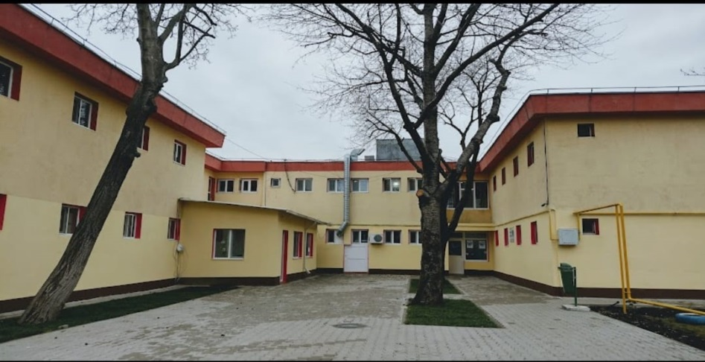
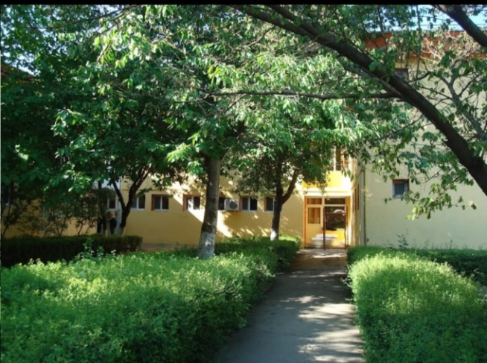
2021-1-RO01-KA220-SCH-000030045
2021-2024

Slide 2

Play, Smile, Love, Color, Emotion, Dream
These are the keywords that guide and represent our work!

Slide 3
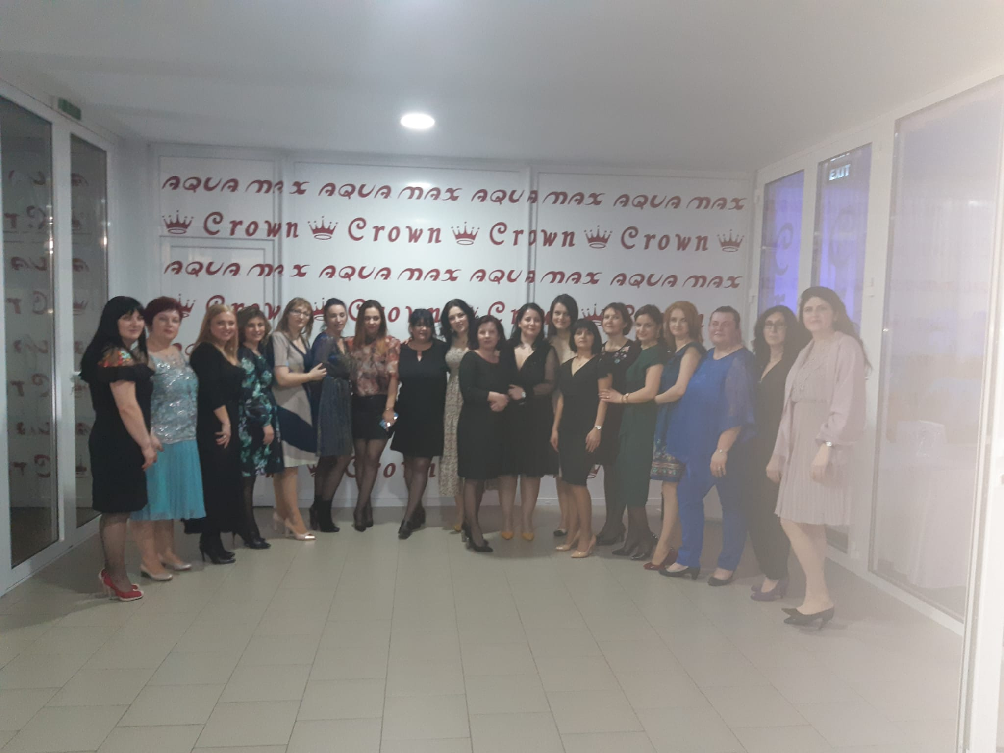
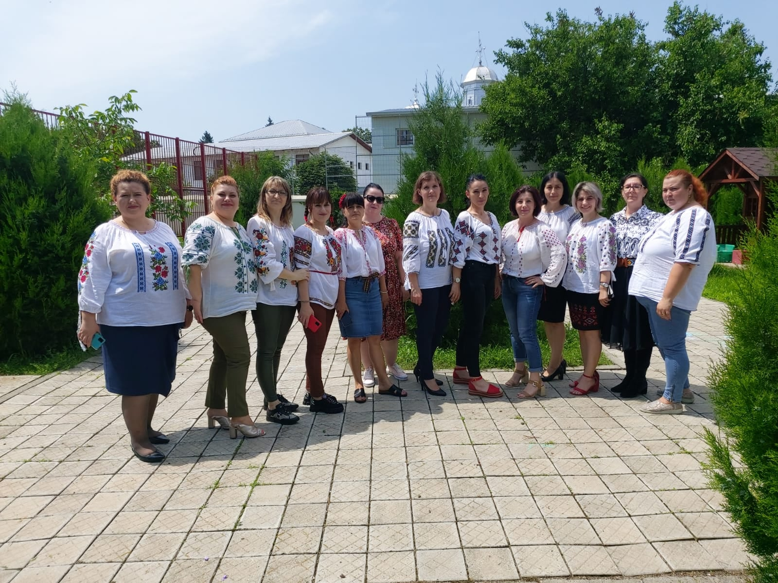
ABOUT US
Our kindergarten was established in 1973 in Buzău County (South-East Romania).
Currently, there are 13 kindergarten classes and 26 preschool teachers,
which welcome around 400 preschoolers every day.
This makes us the largest kindergarten in the town!

Slide 4
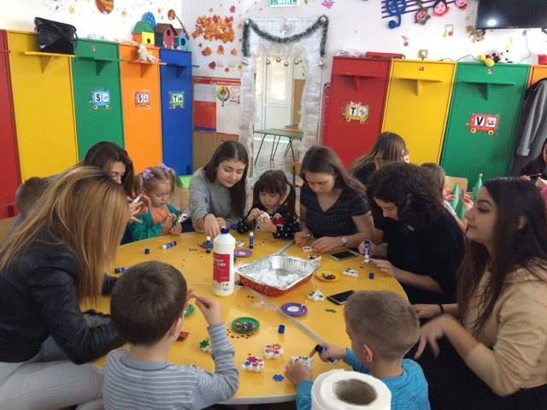
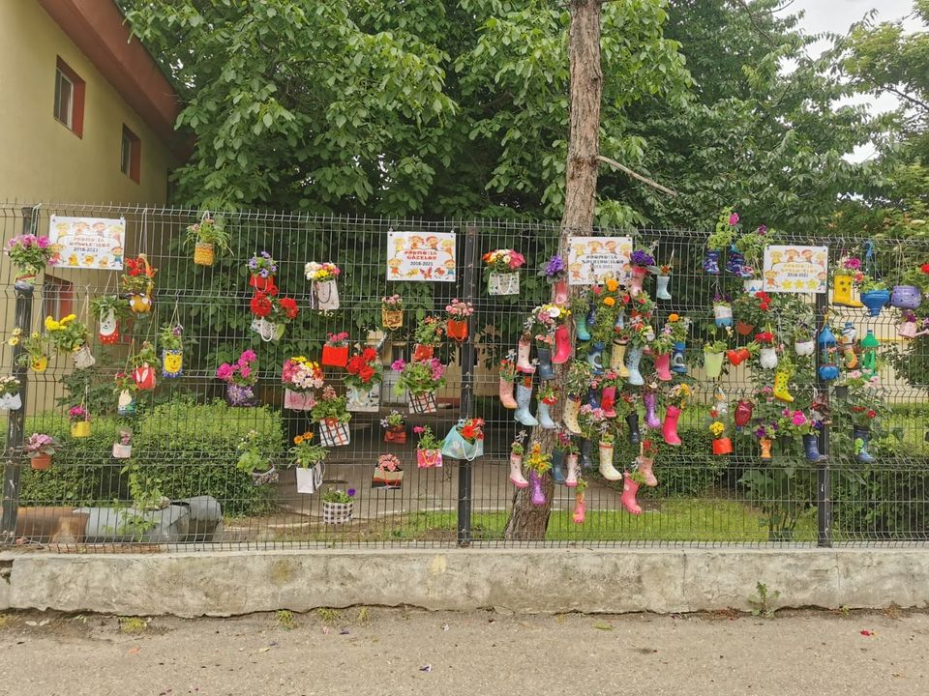
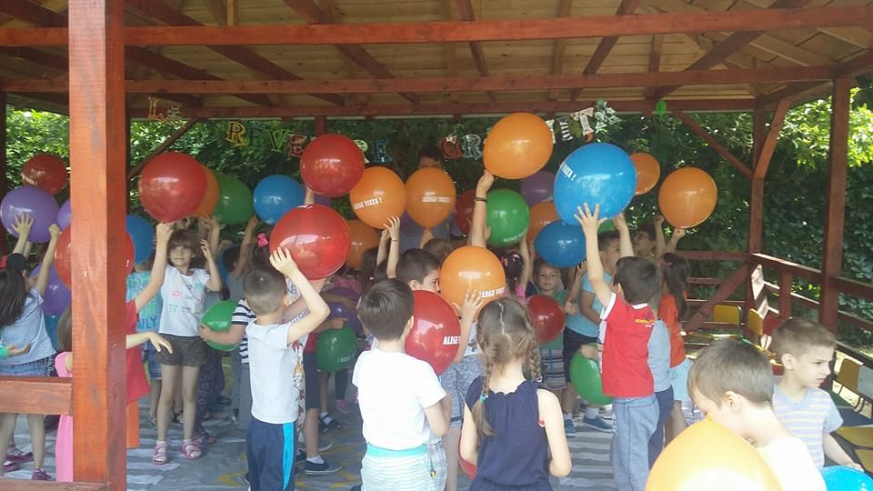
OUR MISSION
Our kindergarten promotes a child-centered education using fun, integrative, and innovative activities.
We aim to bring out the best in our children, simultaneously equipping them with everything they need to feel comfortable in society and in their future school life.

Slide 5
EDUCATIONAL SERVICES
Currently, our main educational services include:
Didactic activities tailored to the child’s age and level of development
Psycho-pedagogical assistance (individual/group)
Meals & rest
Speech therapy
OPTIONAL SERVICES:
English Language
Dancesport
Good Manners
Music
Storytelling
The Small Christian
The Small Ecologist
Financial Education
Entrepreneurial Education
EXTRACURRICULAR SERVICES:
Shows and exhibits
Visits to cultural and historical institutions; tourism
Educational activities organized in partnership with diverse social and cultural actors: theatre, museum, library, church, Children’s Palace, the local police, as well as medical, school, and military institutions

Slide 6
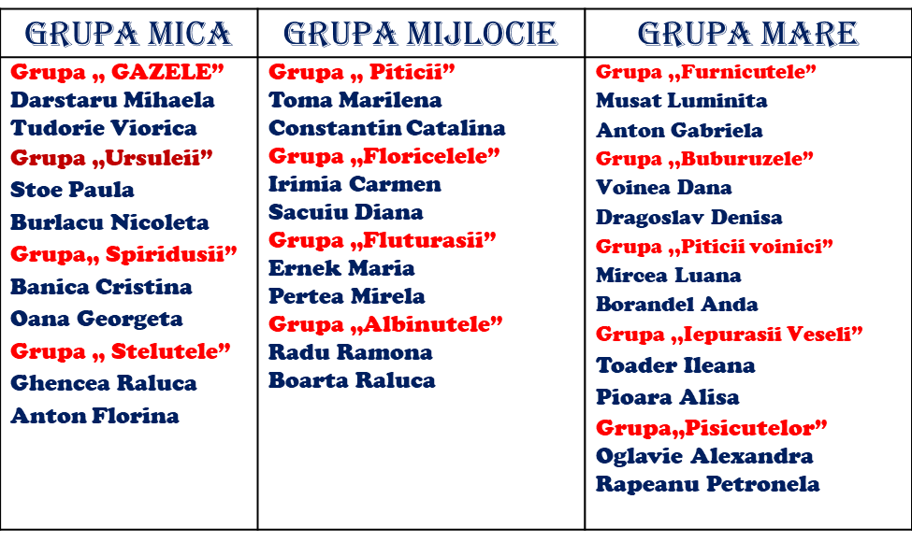
OUR TEACHING UNITS

Slide 7
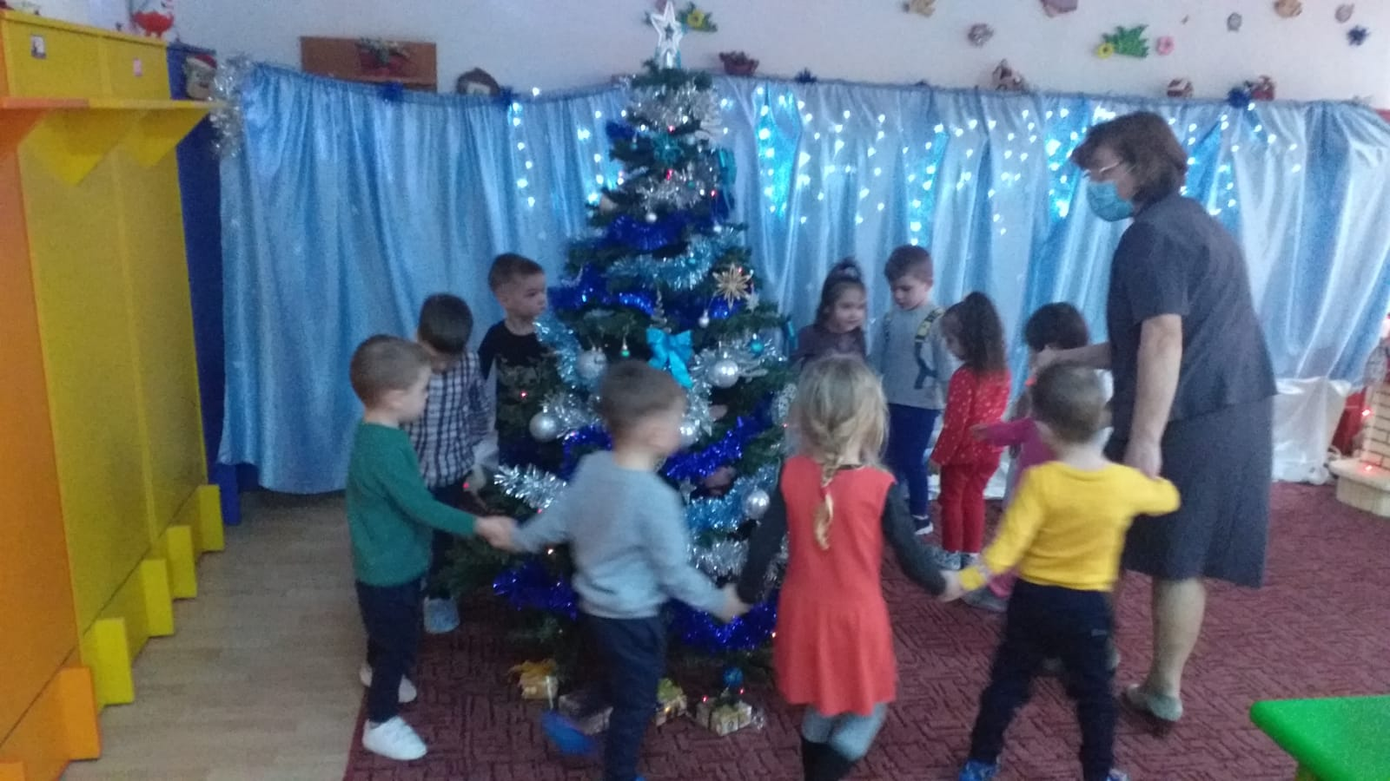
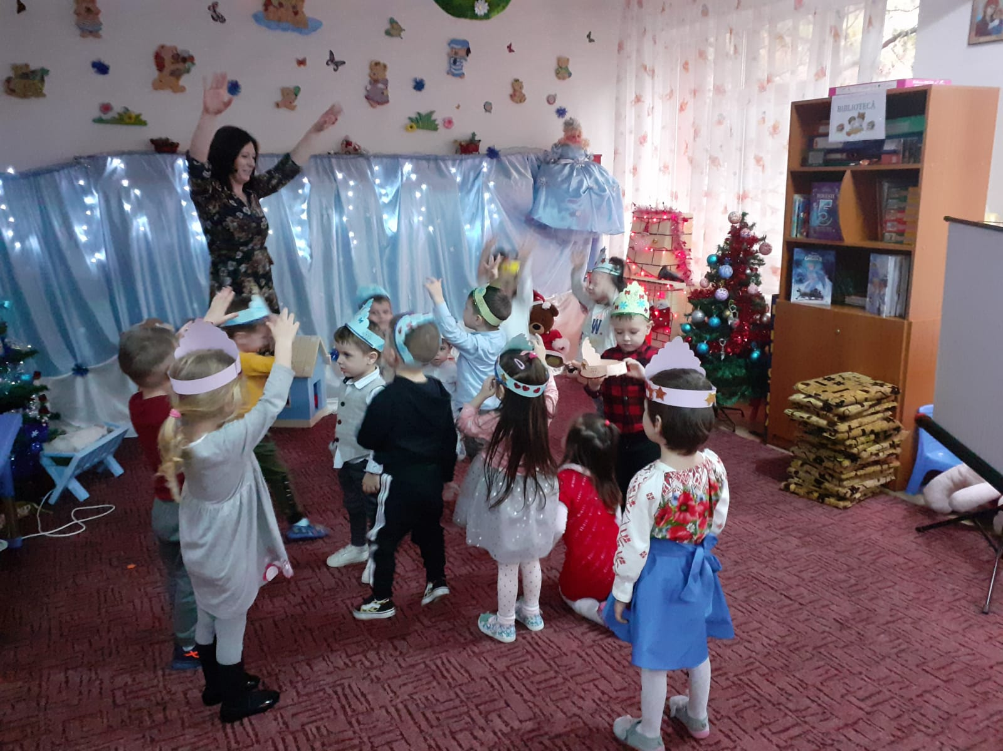
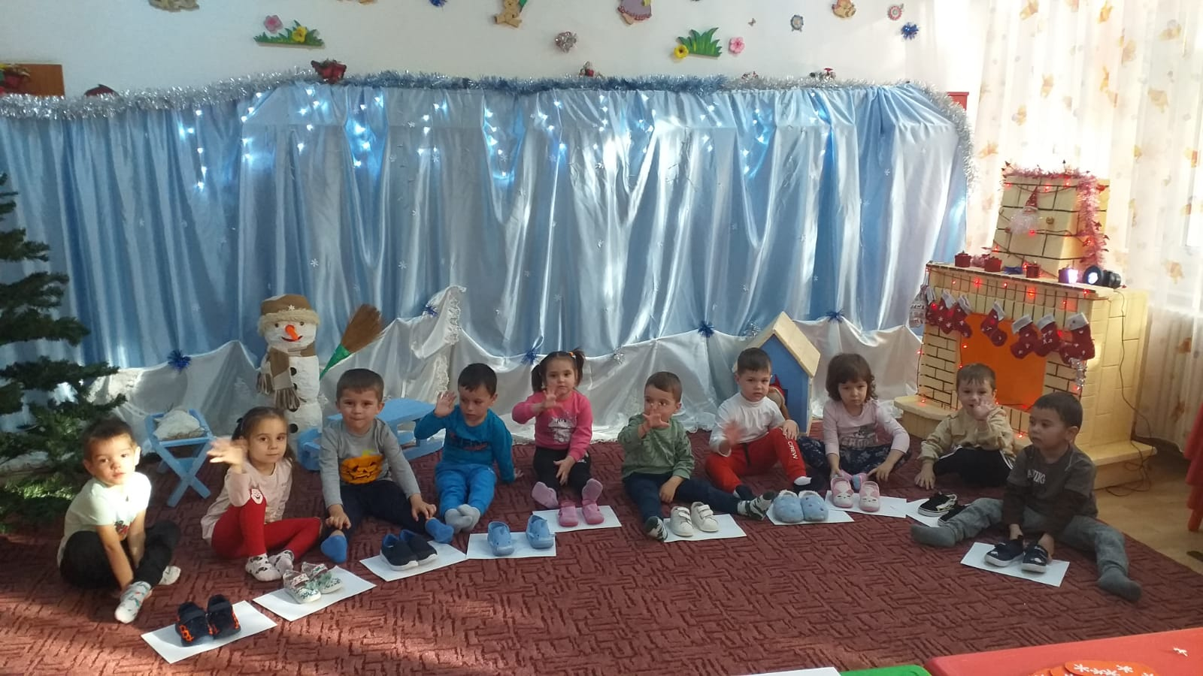
The Bears

Slide 8
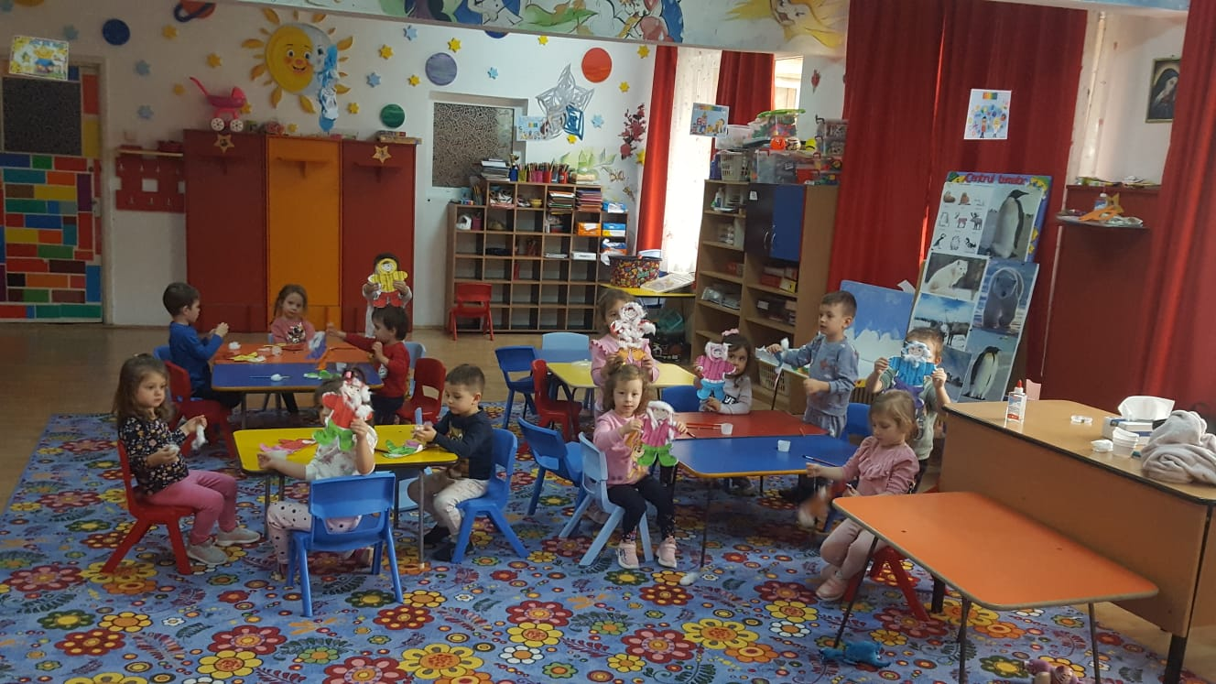
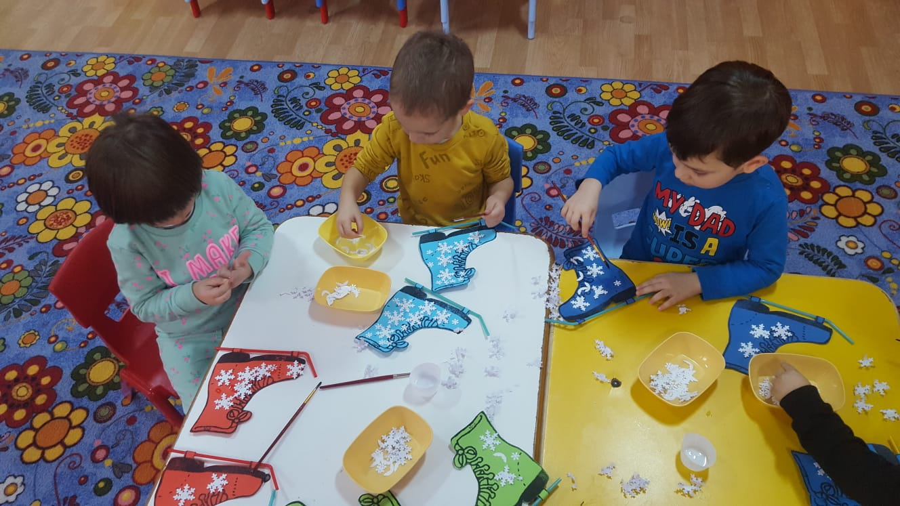
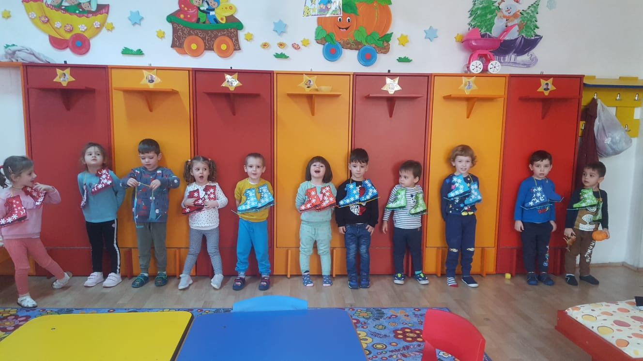
The
Stars

Slide 9
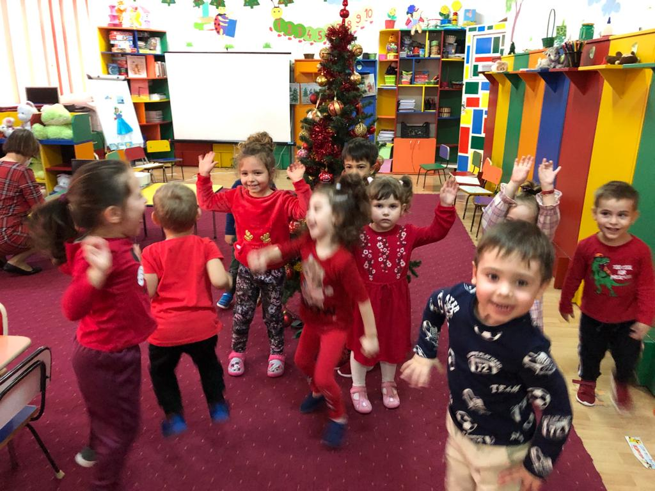
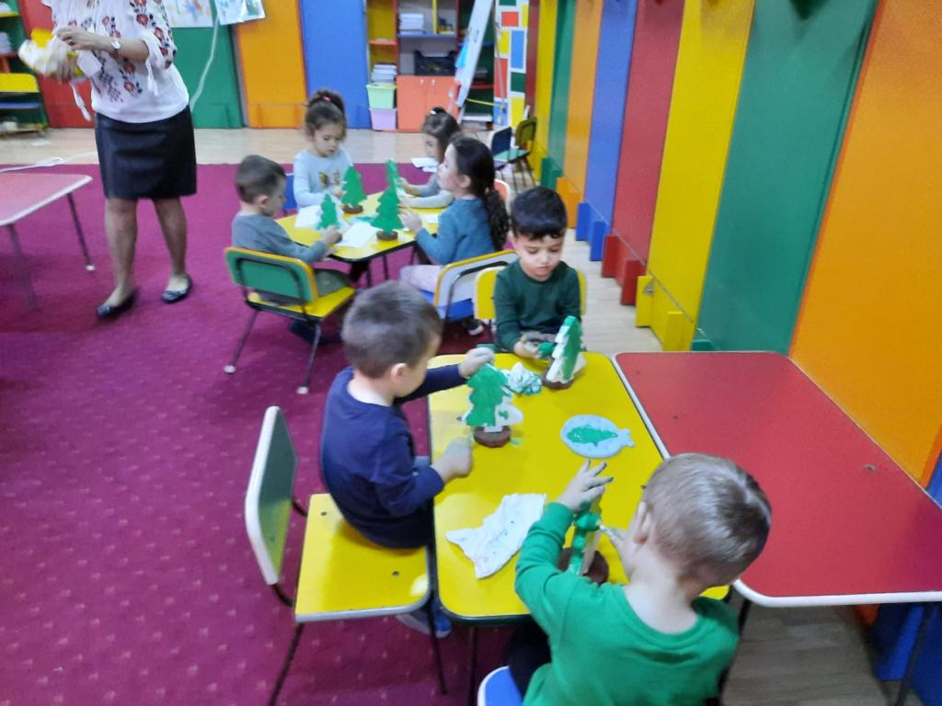
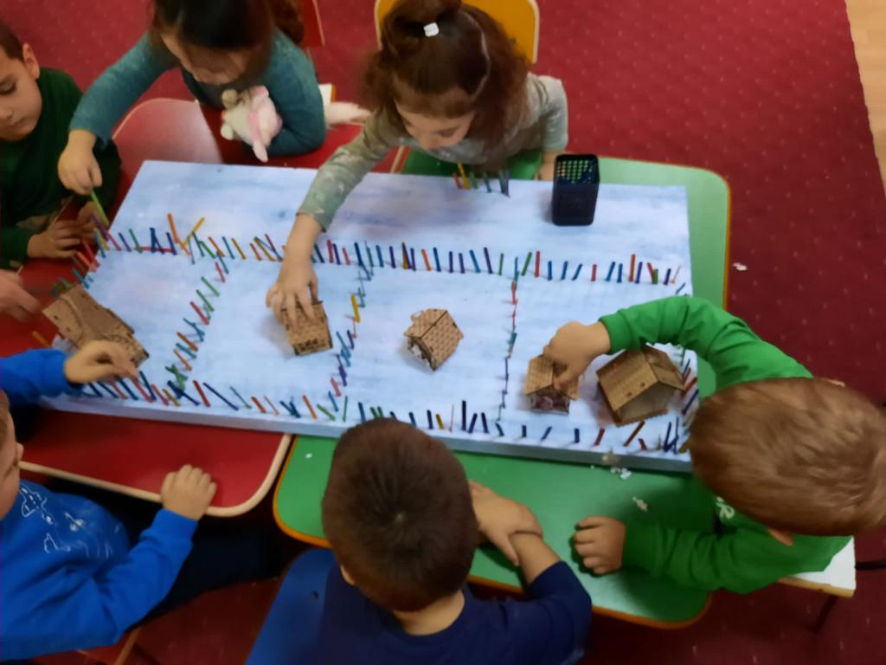
The Insects

Slide 10
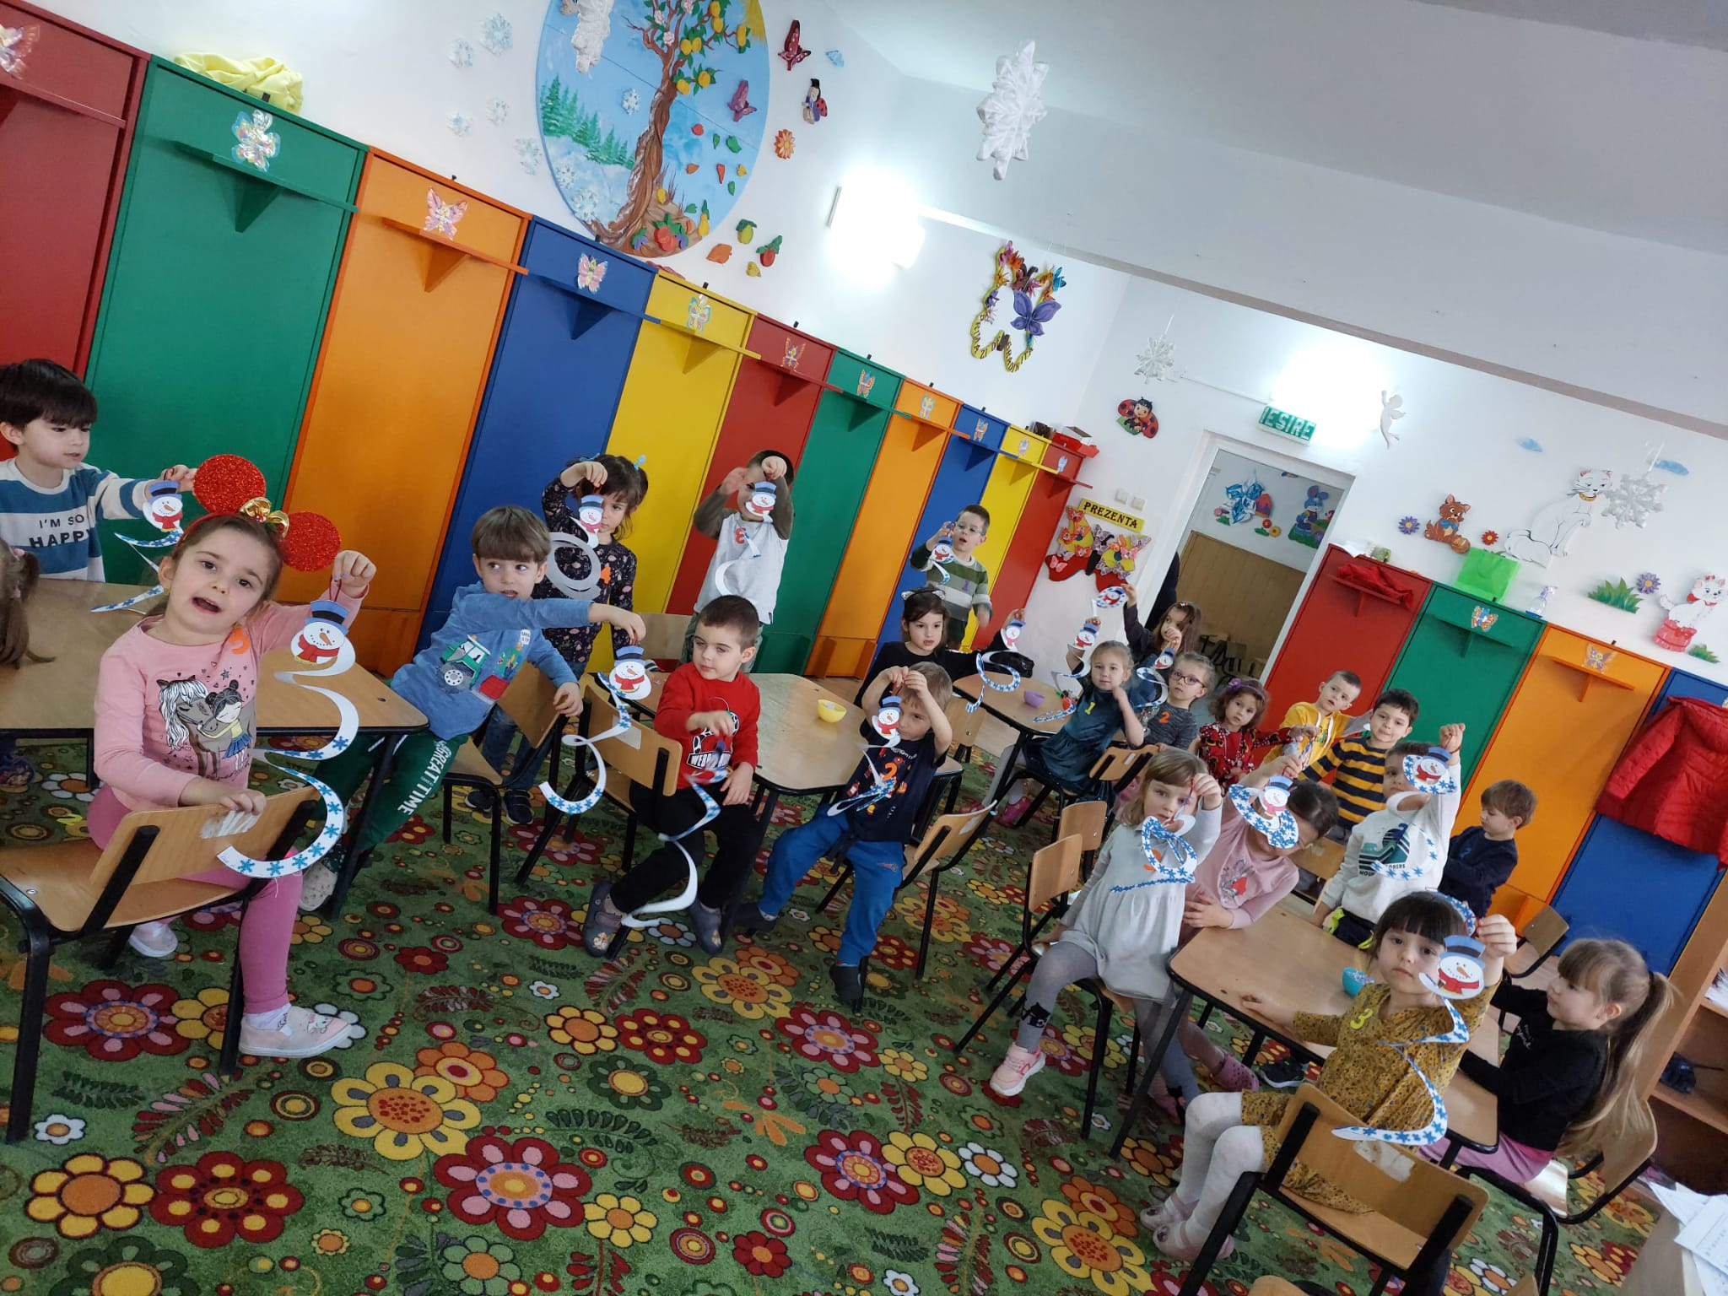
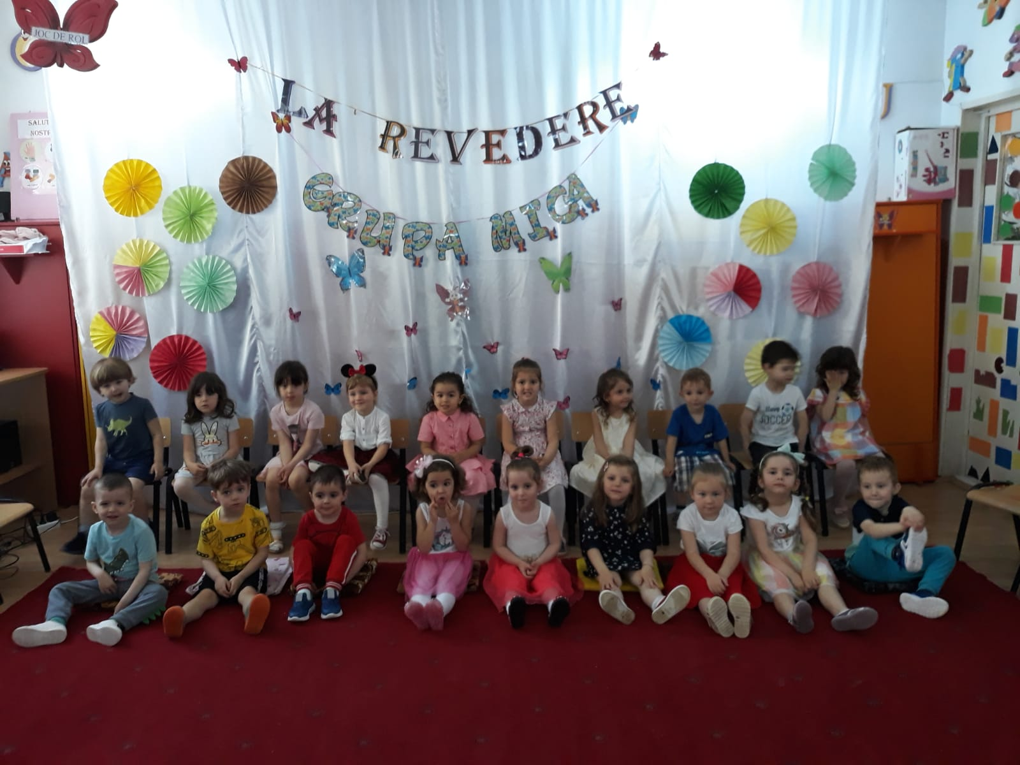
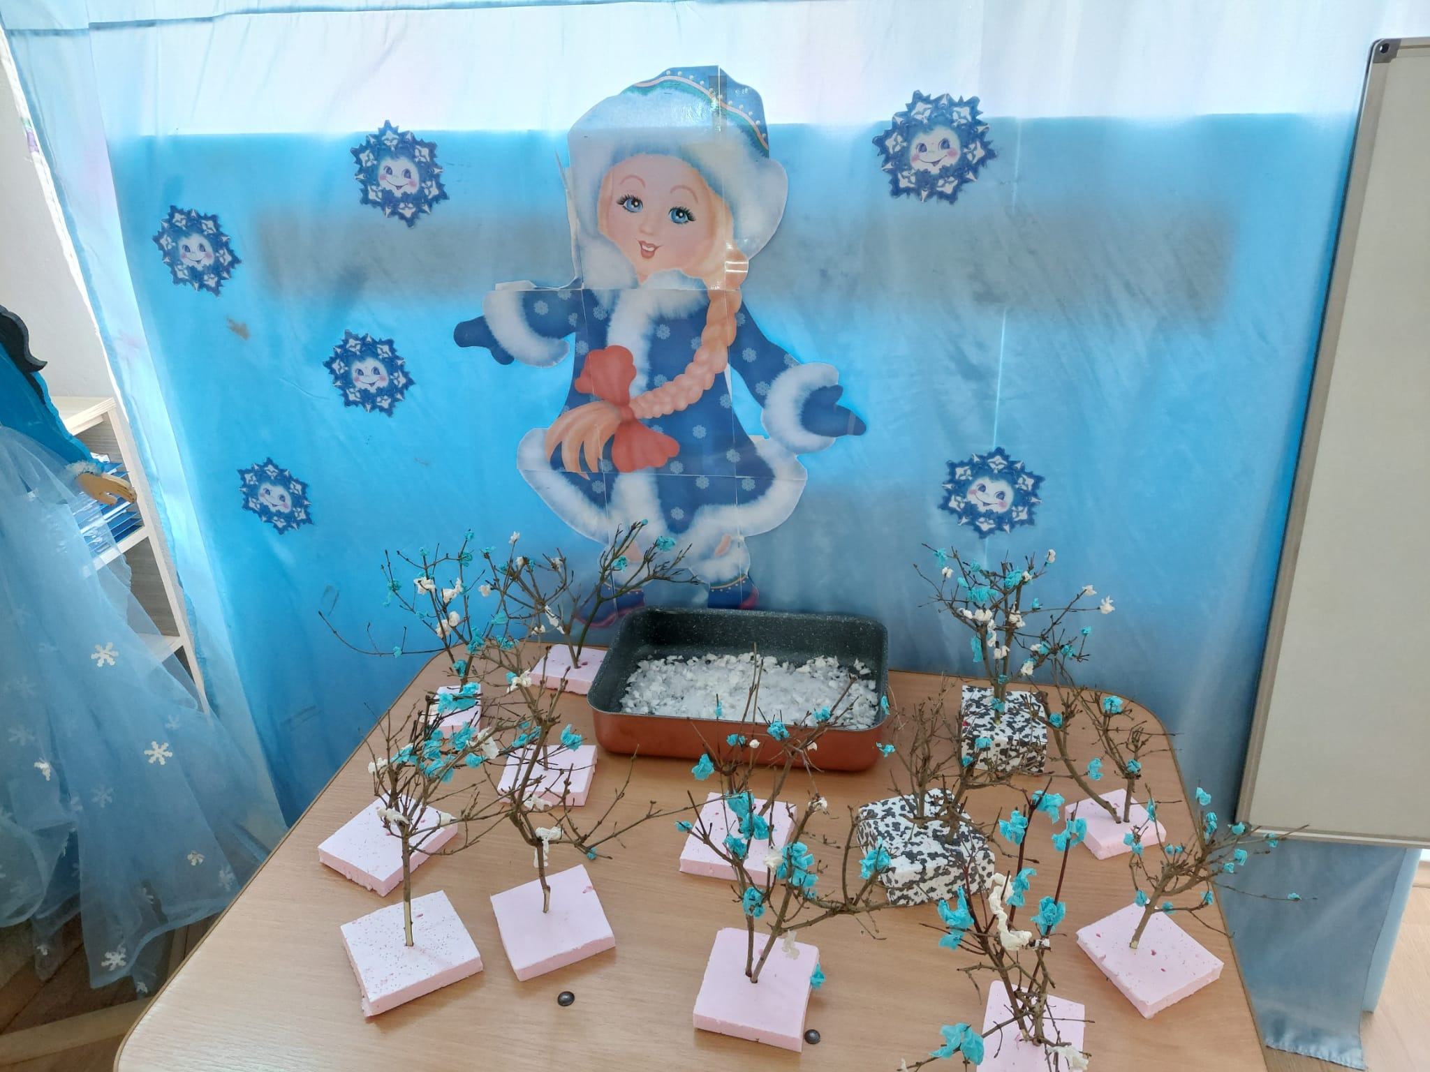
The Butterflies

Slide 11
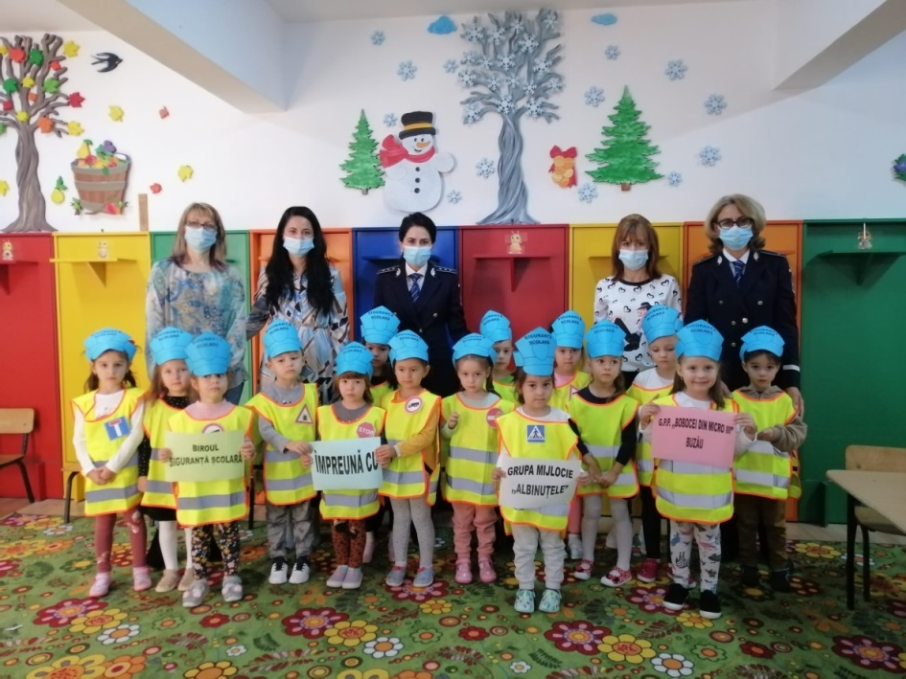
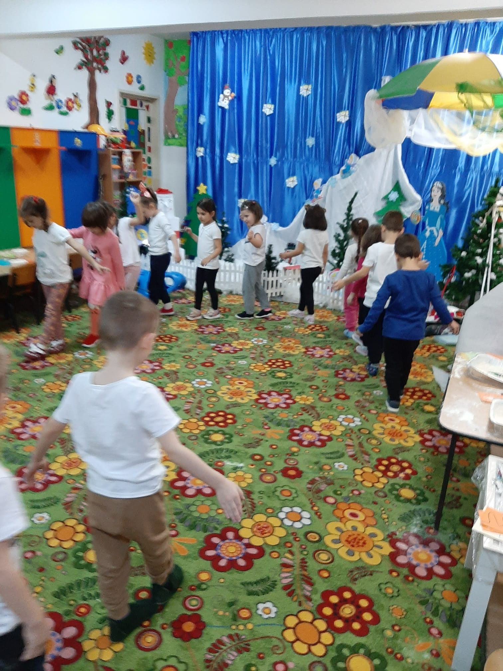
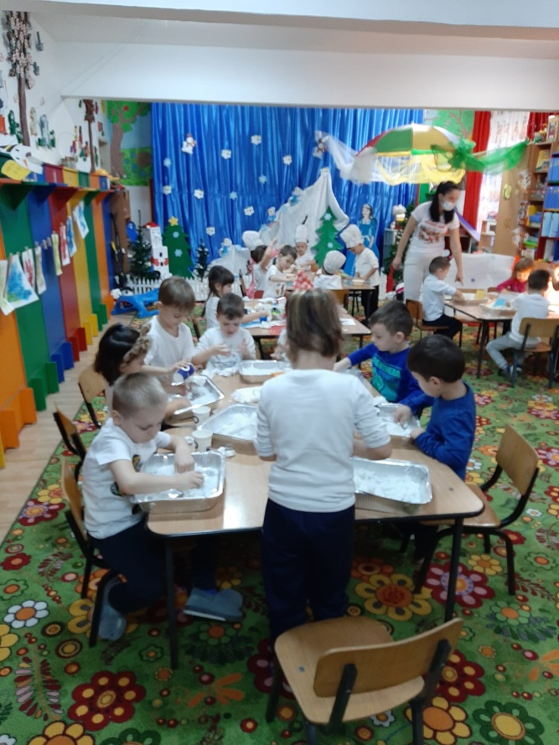
The Bees

Slide 12
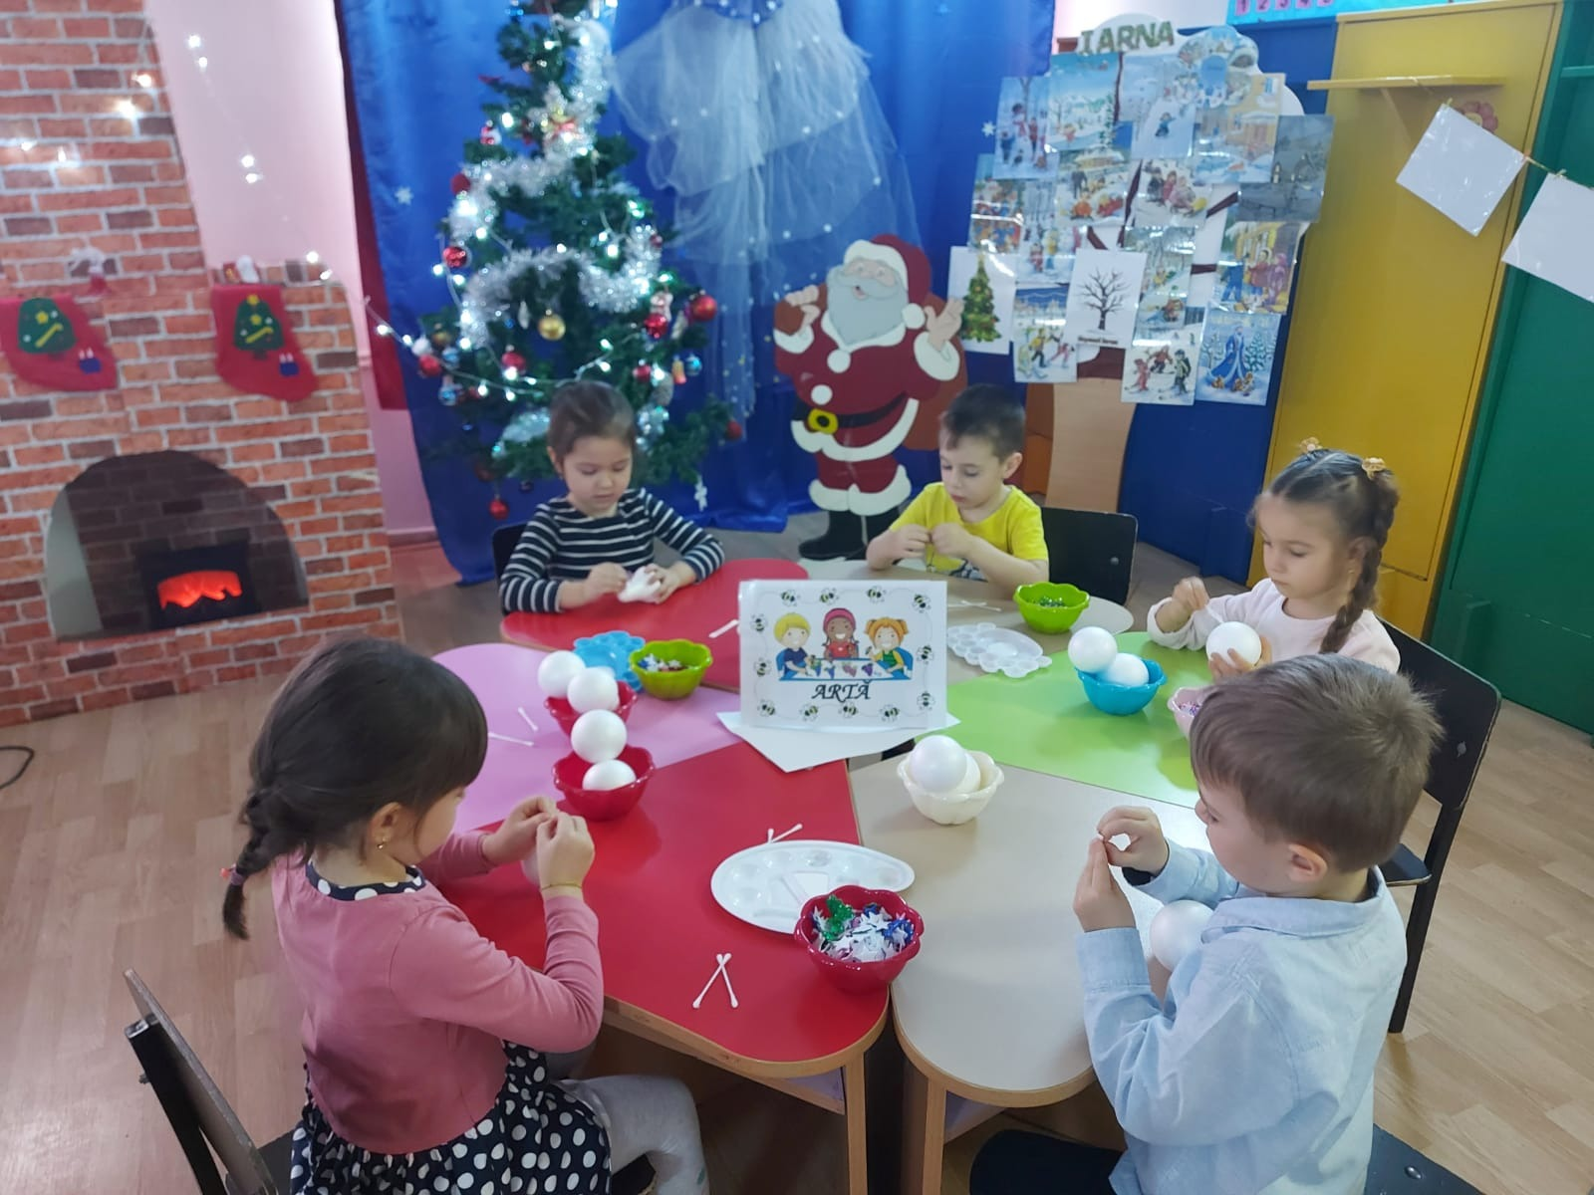
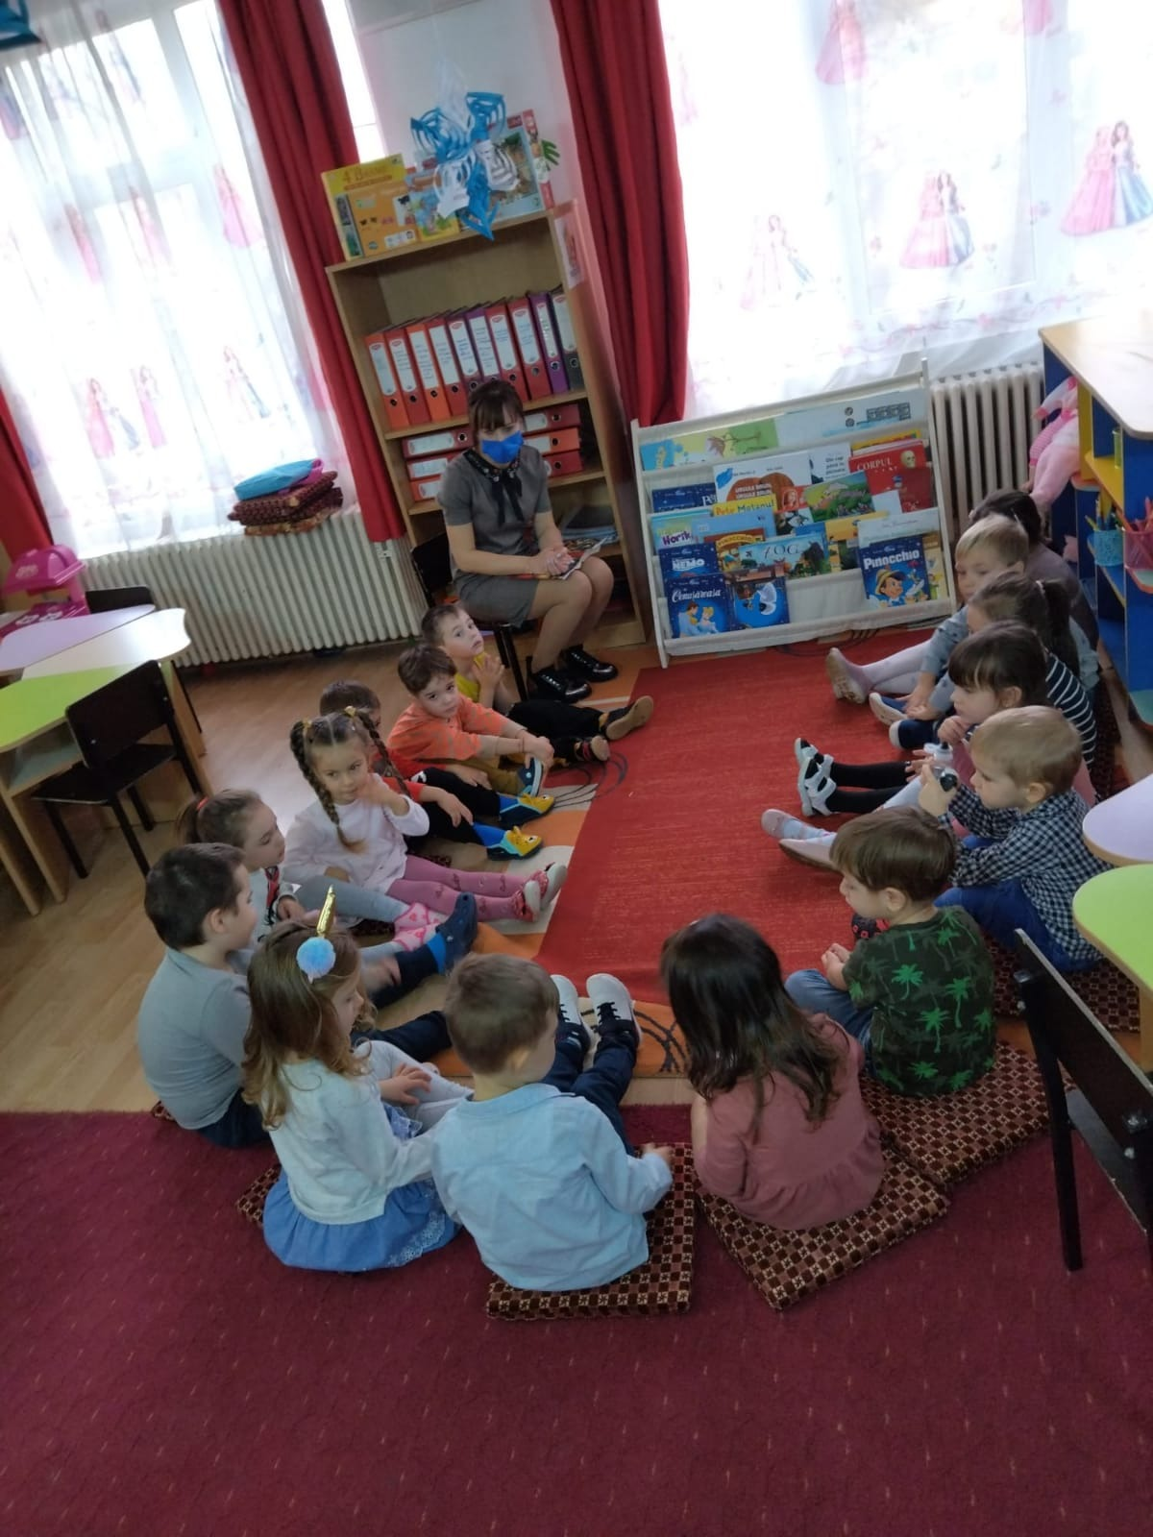
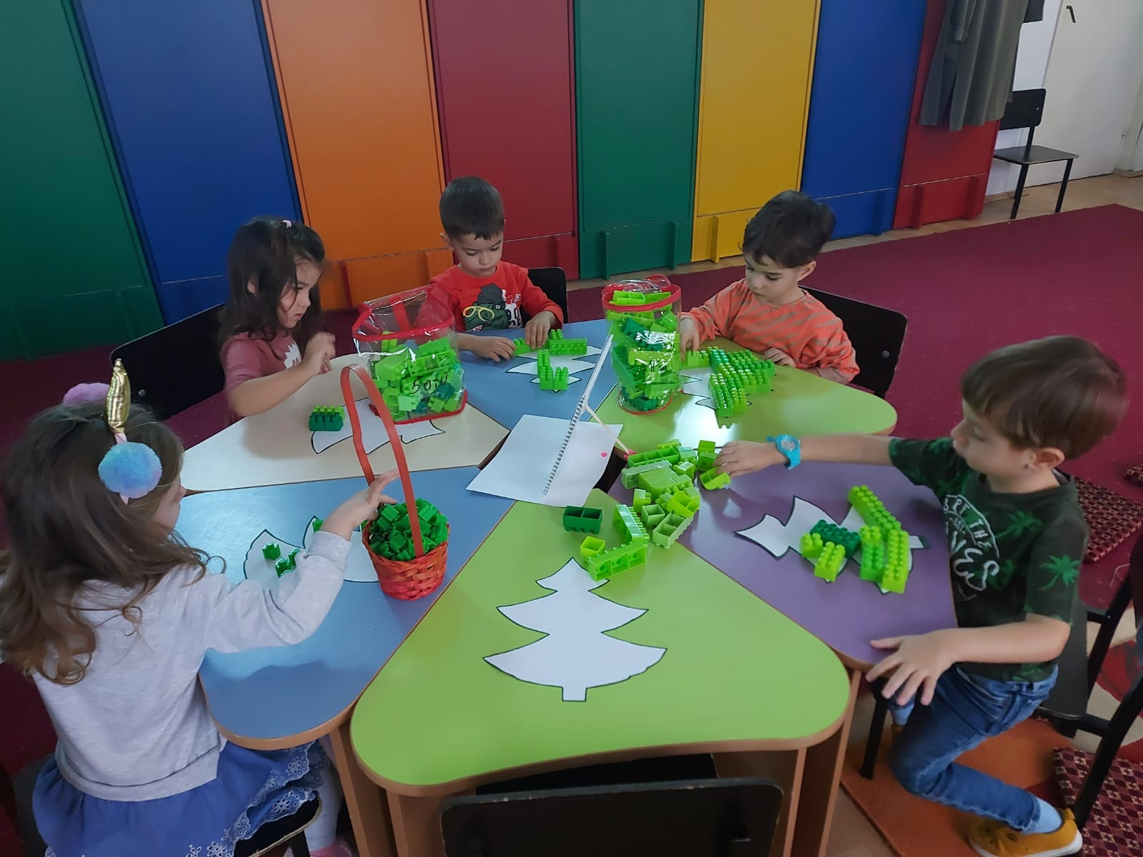
The
Flowers

Slide 13
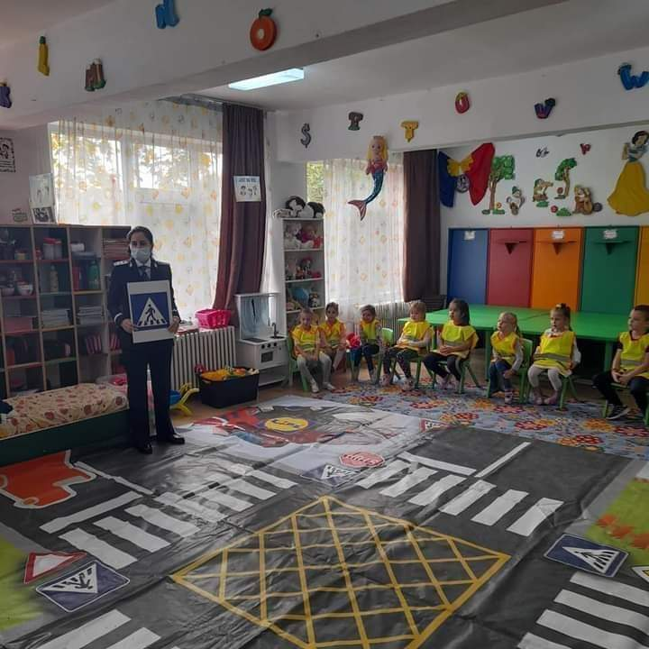
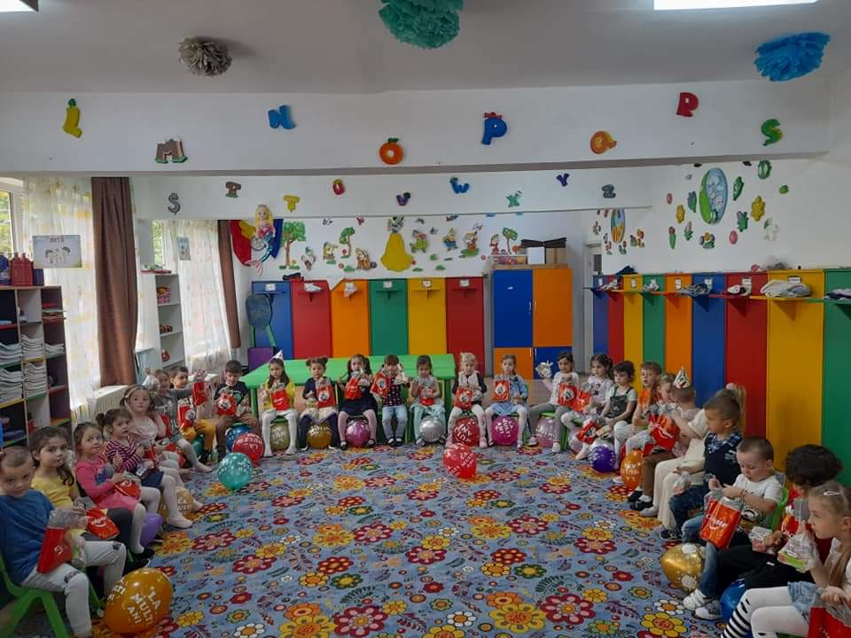
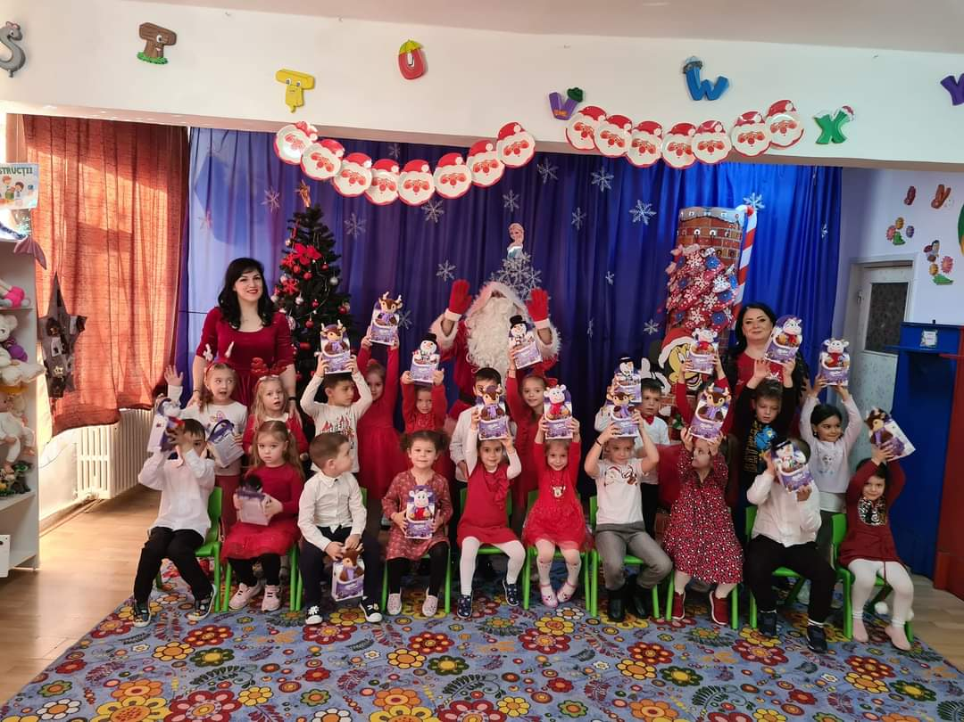
The Elves

Slide 14
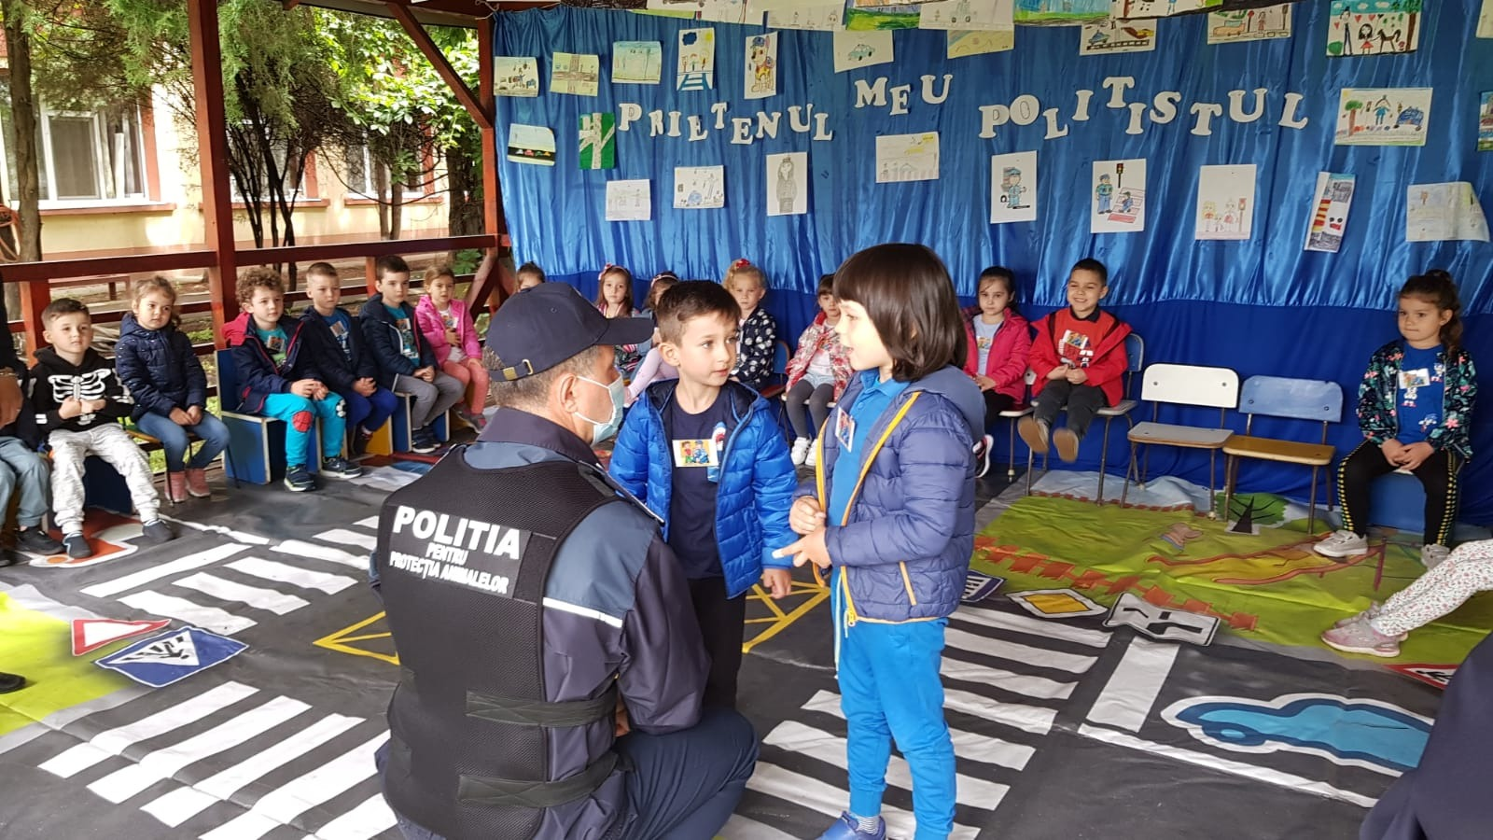
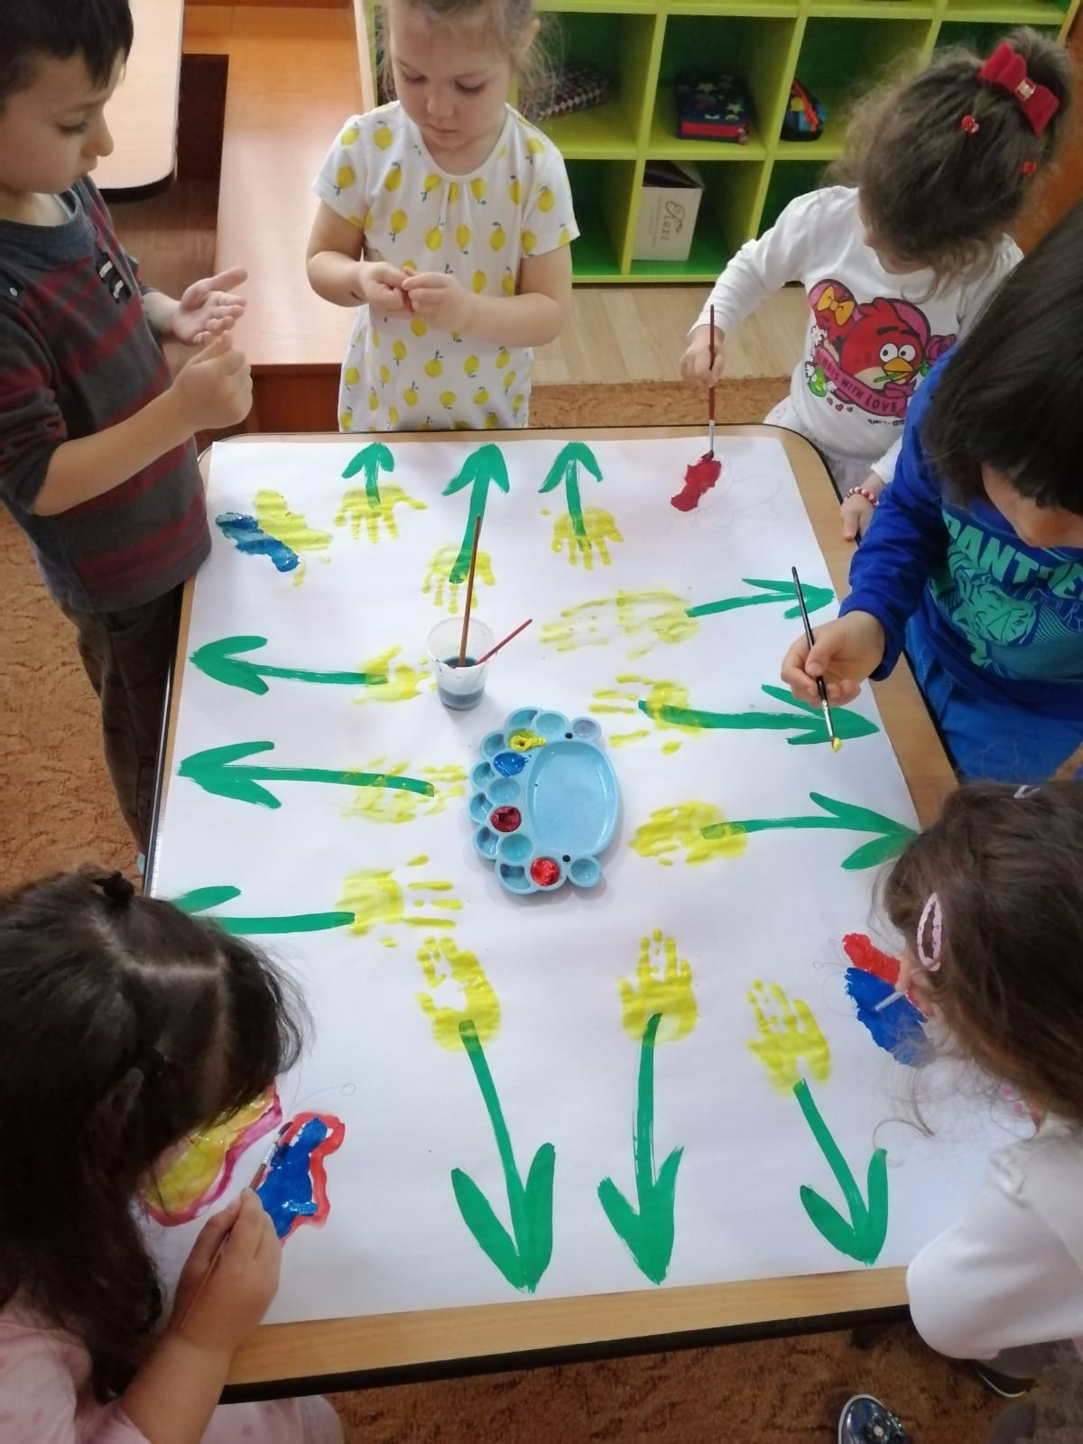
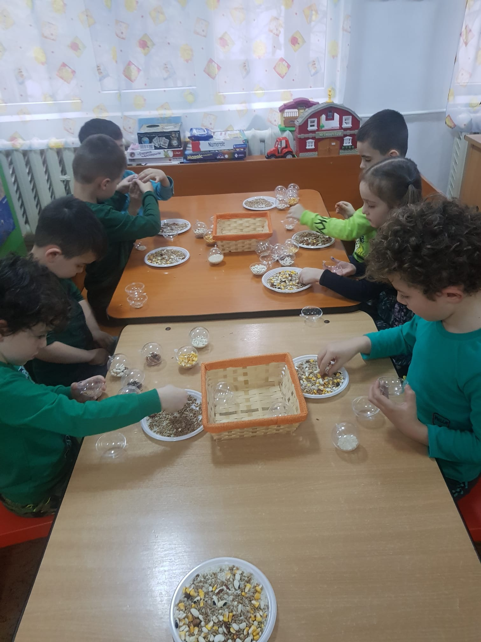
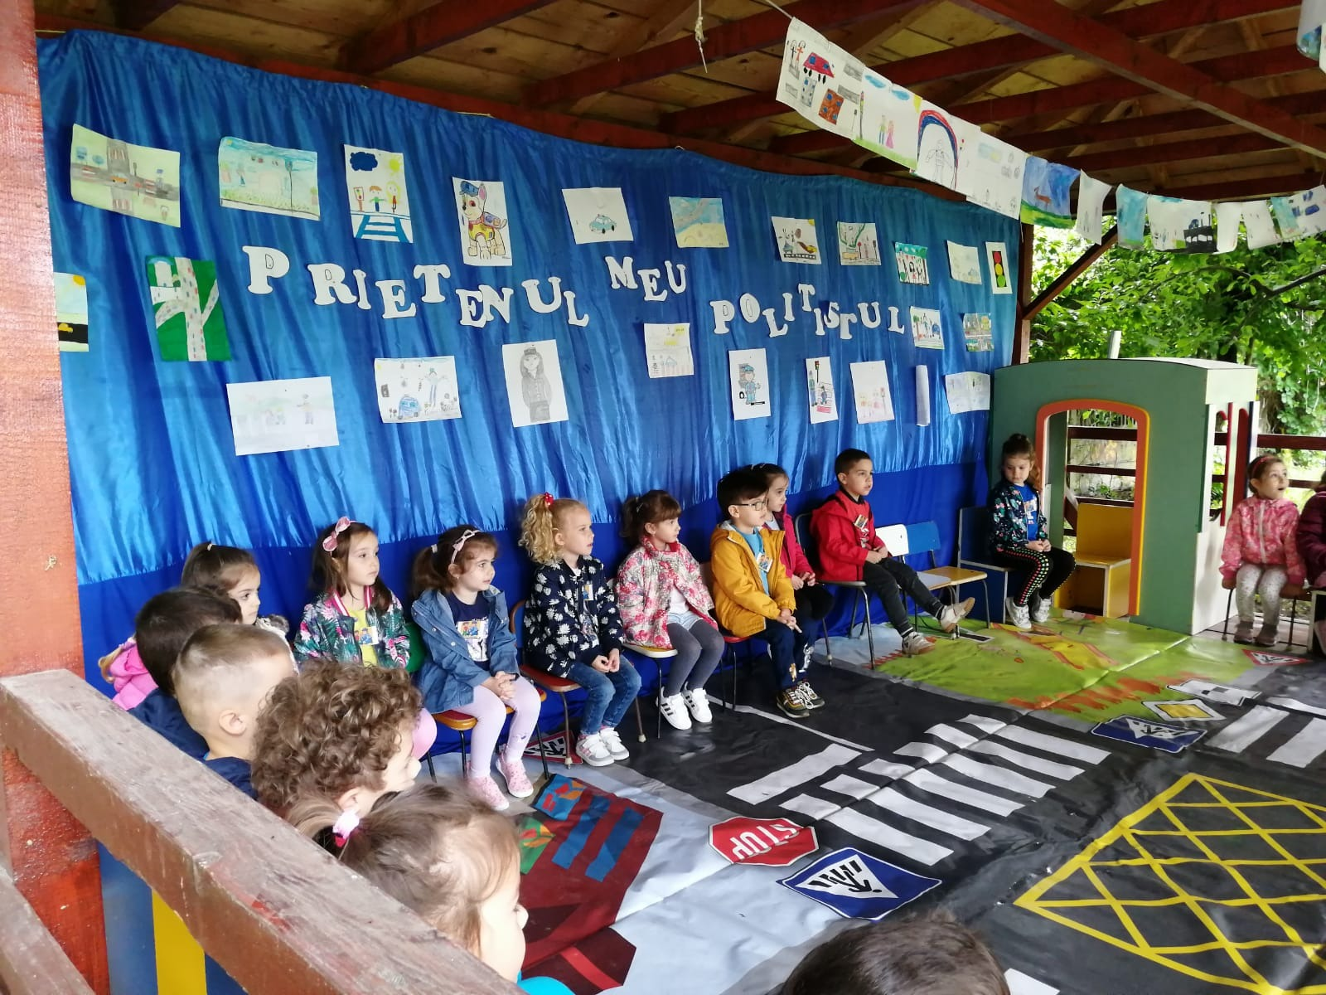
The Ladybugs

Slide 15
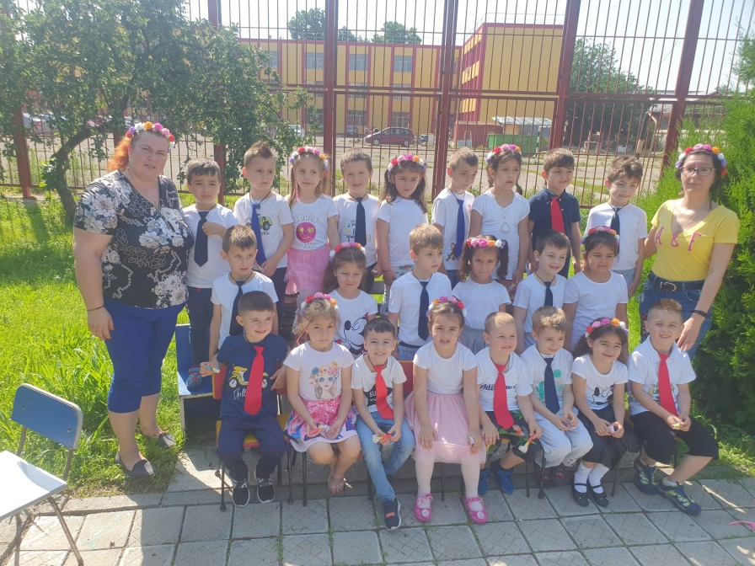
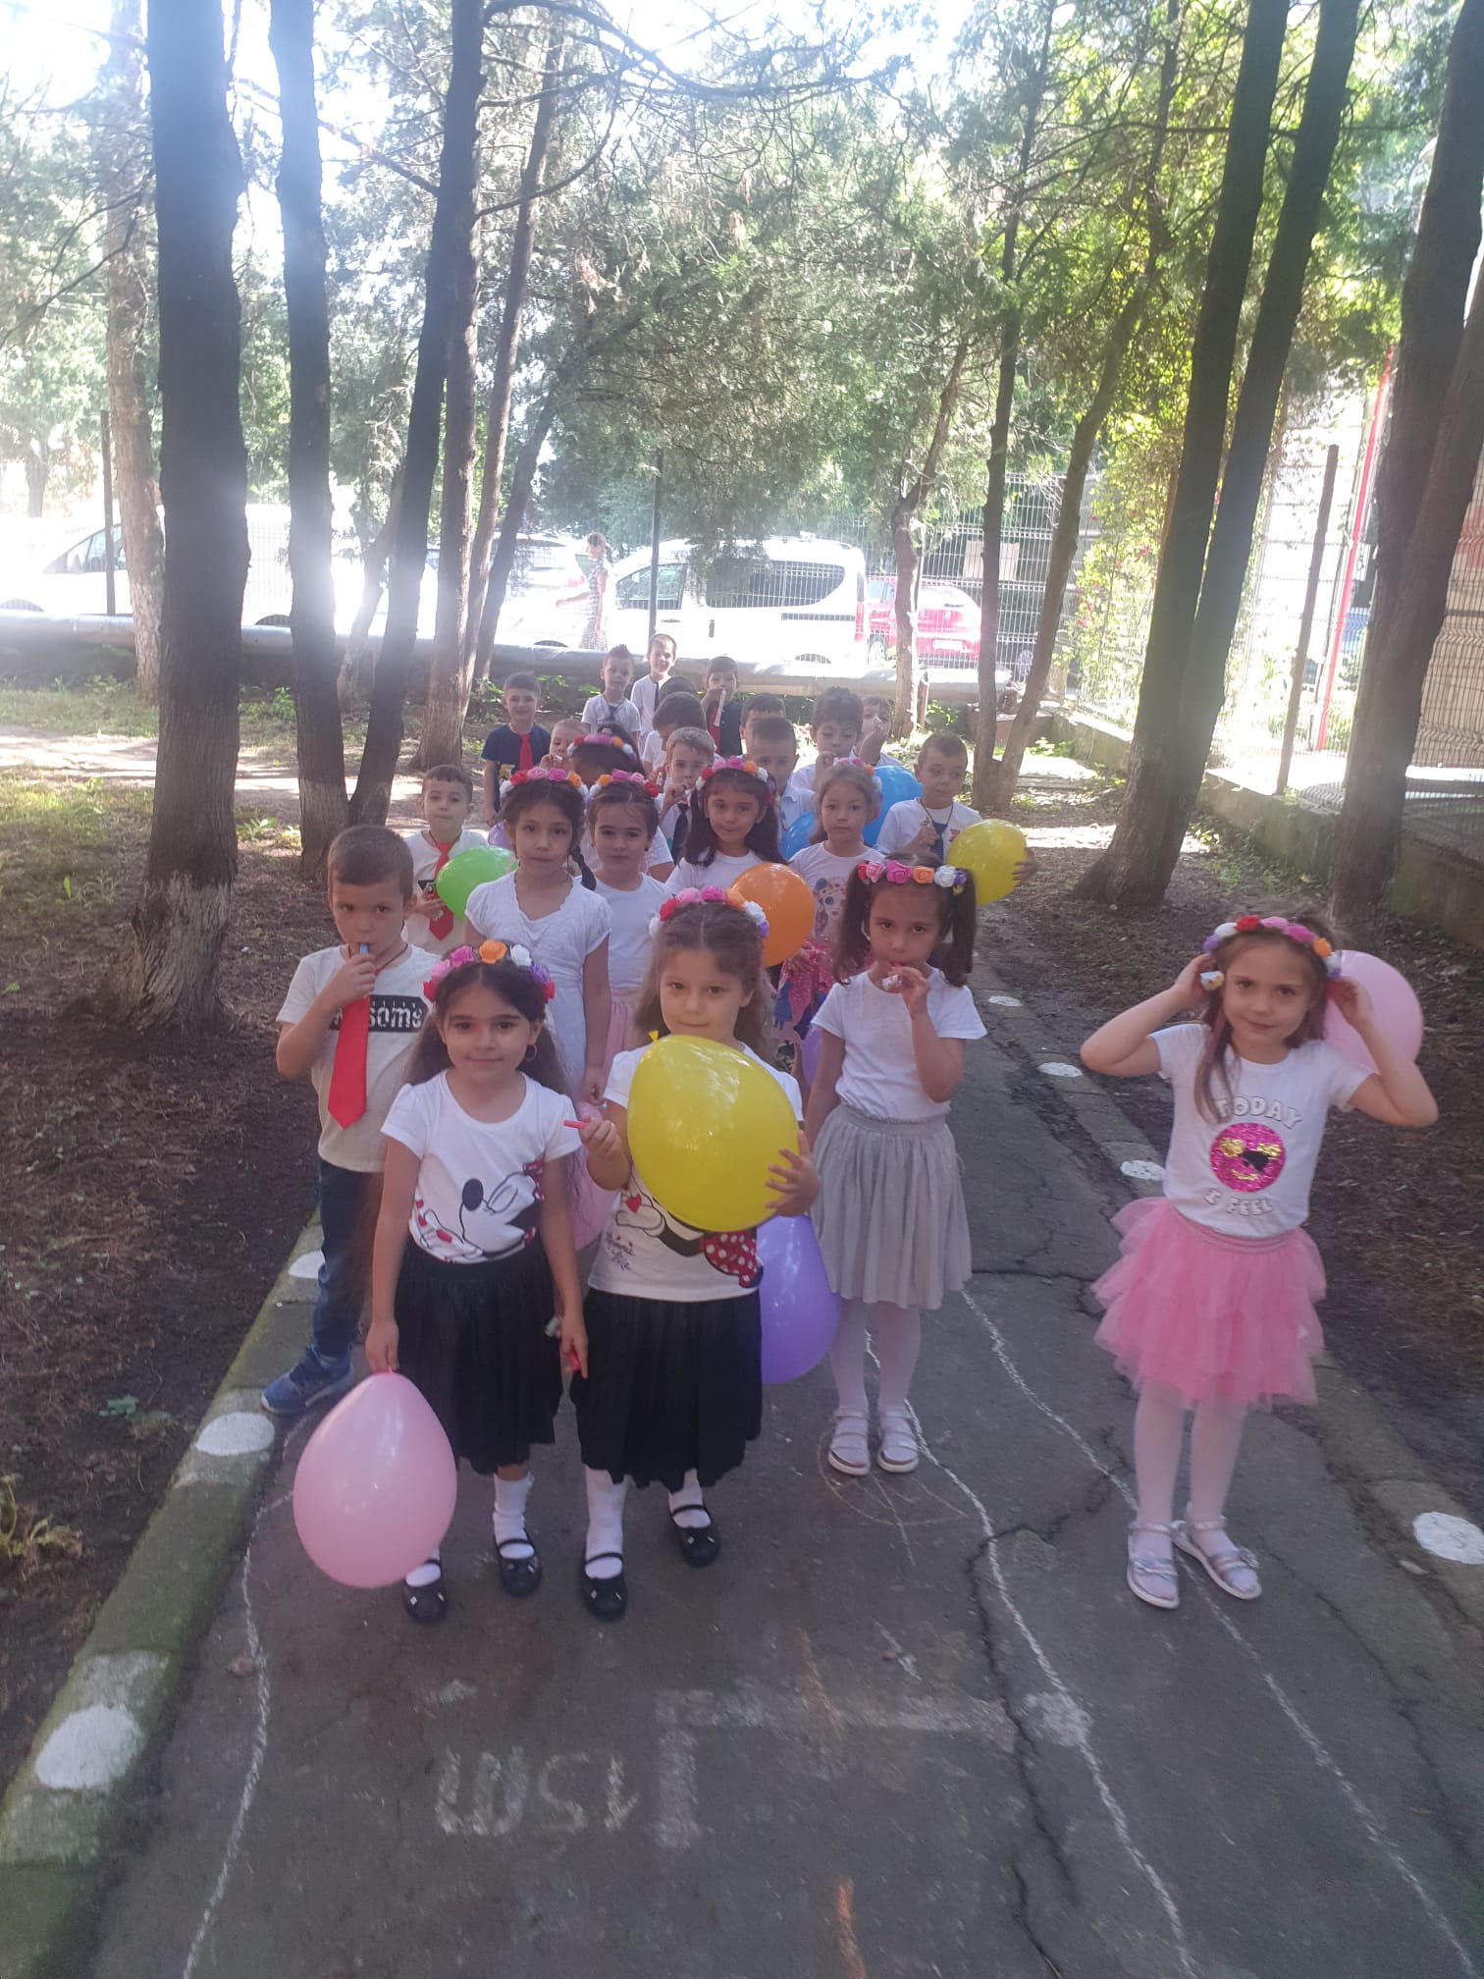
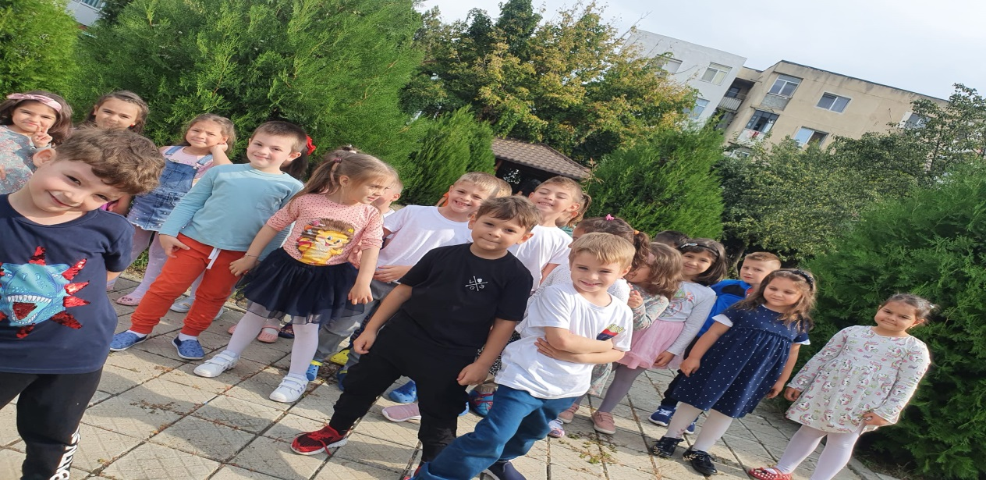
The
Ants

Slide 16
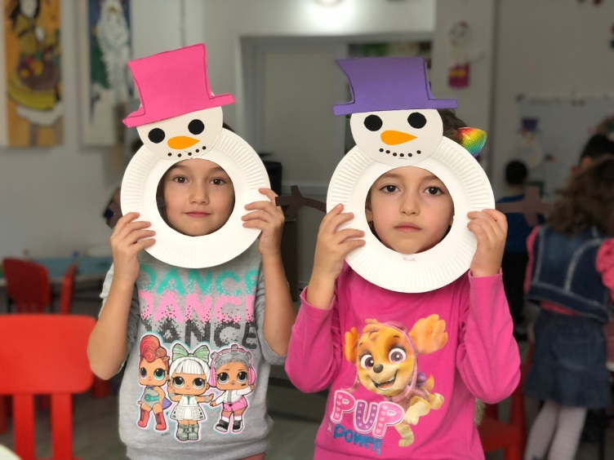
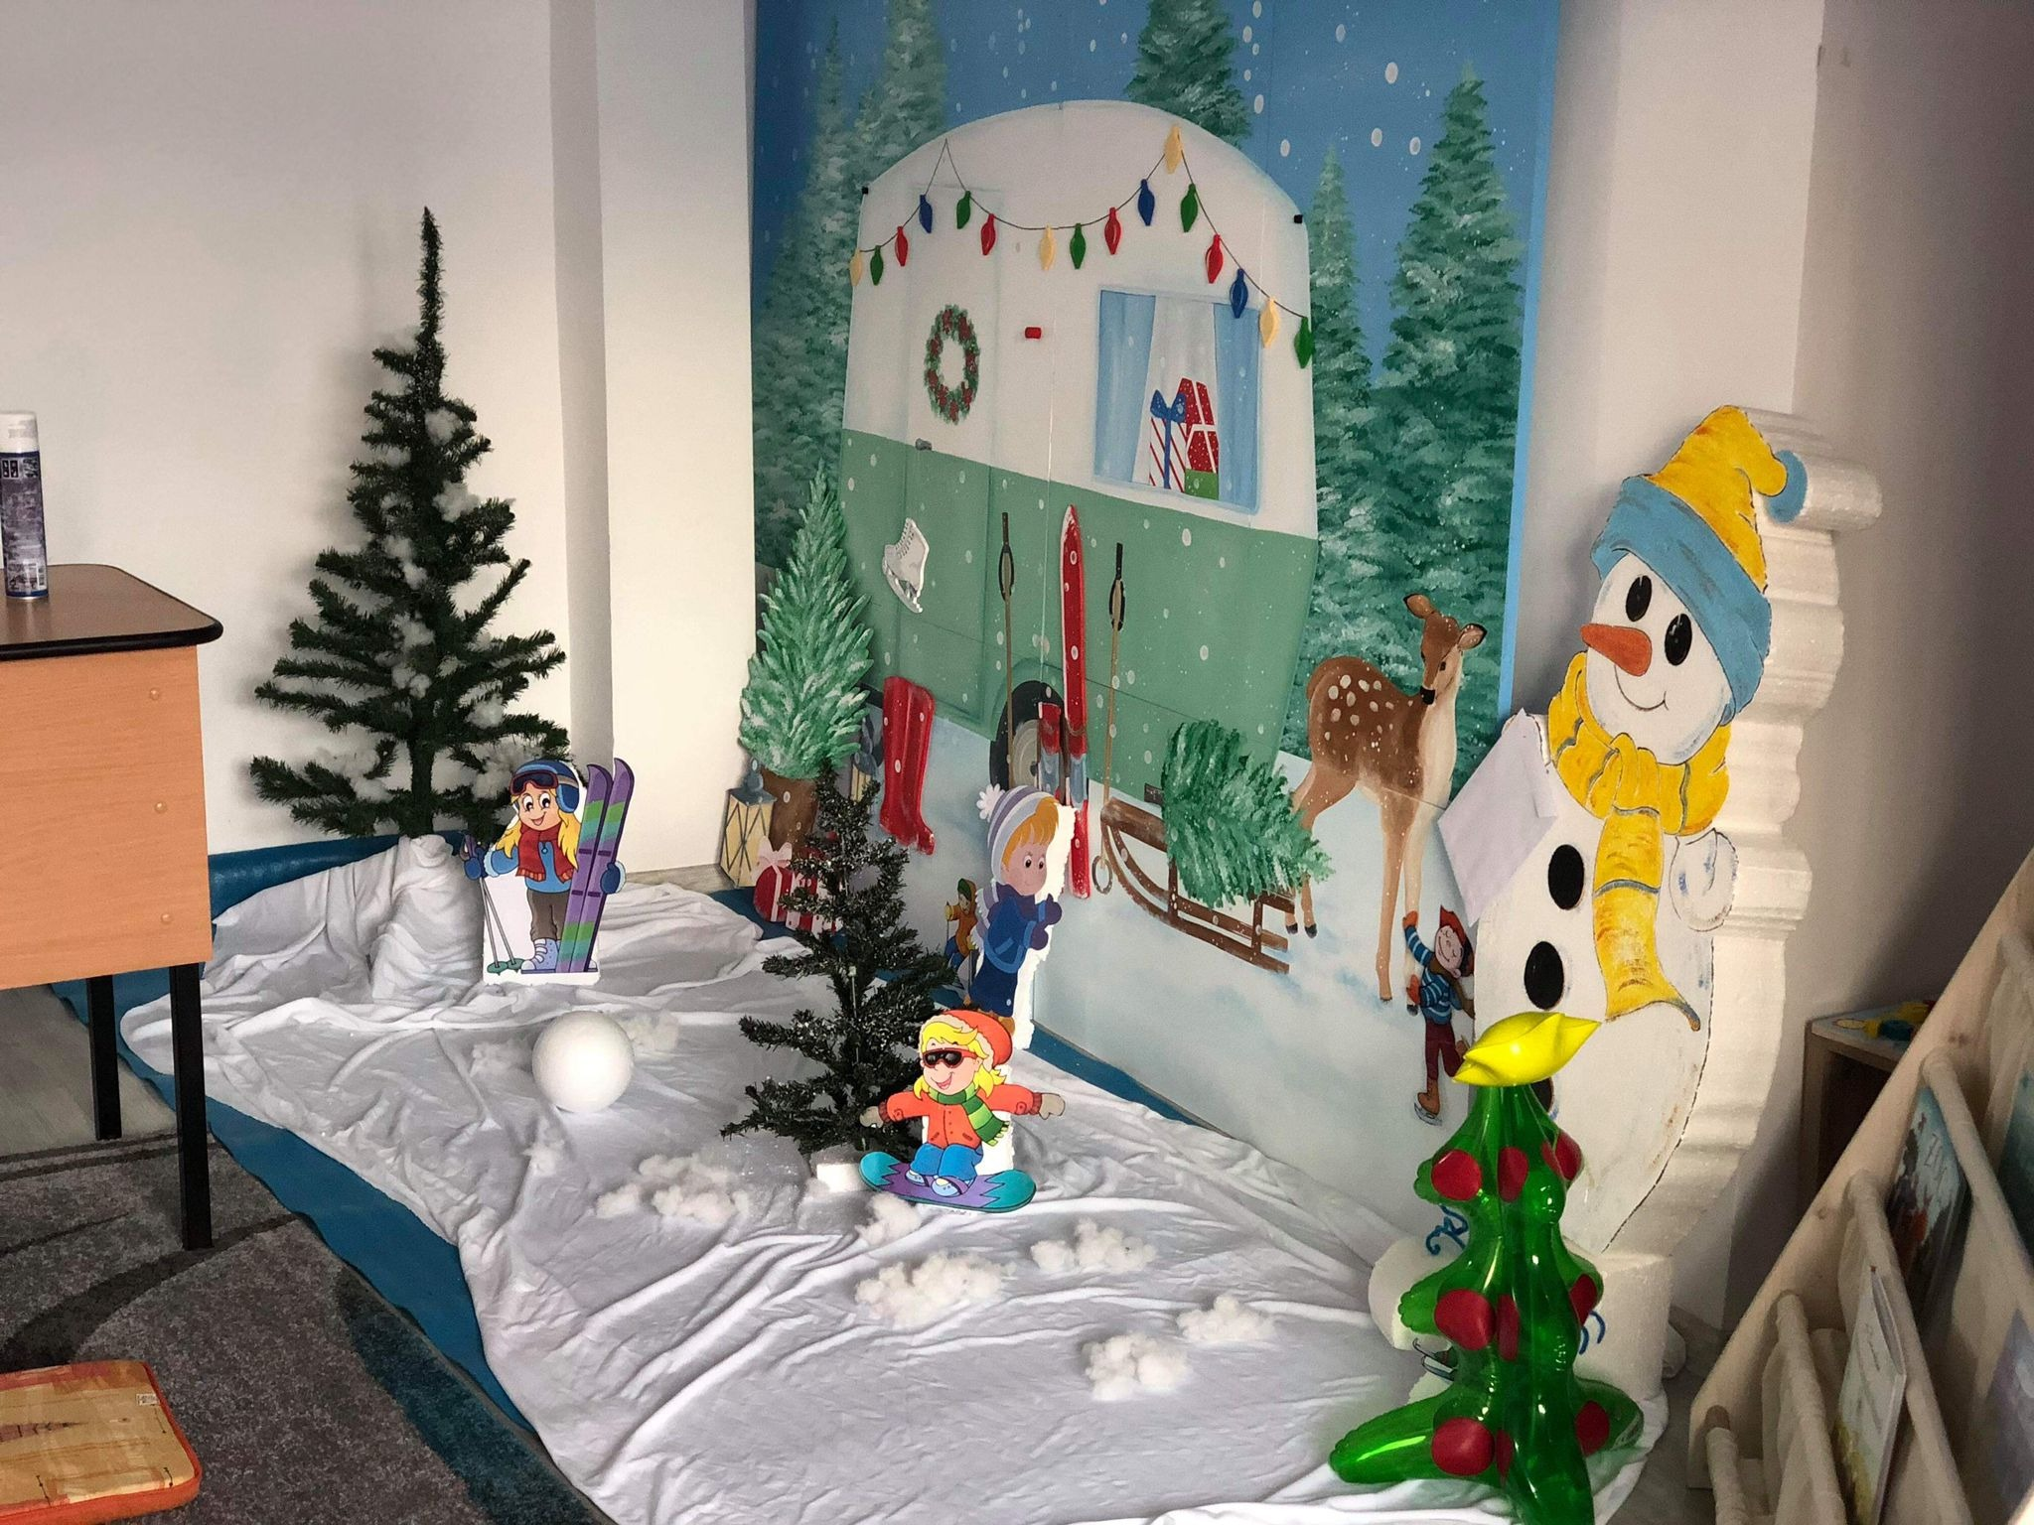
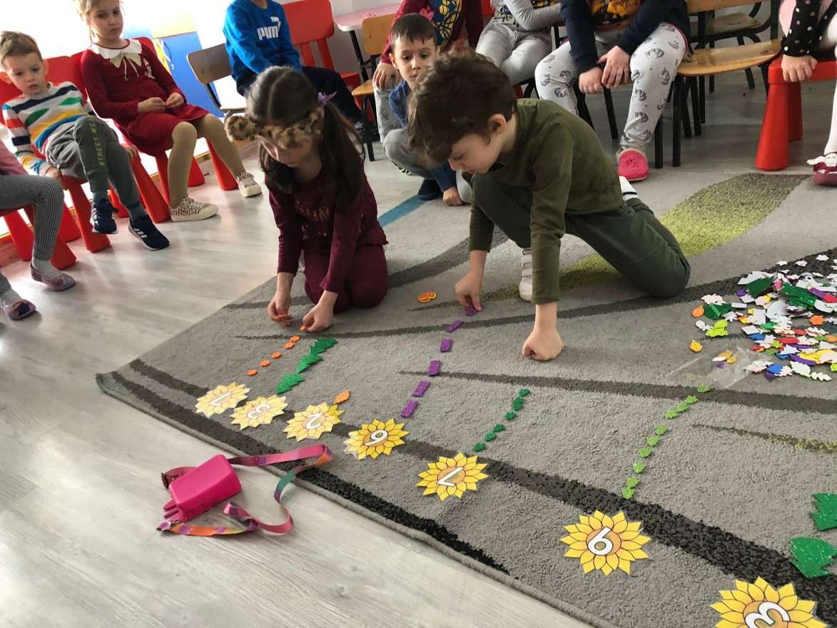
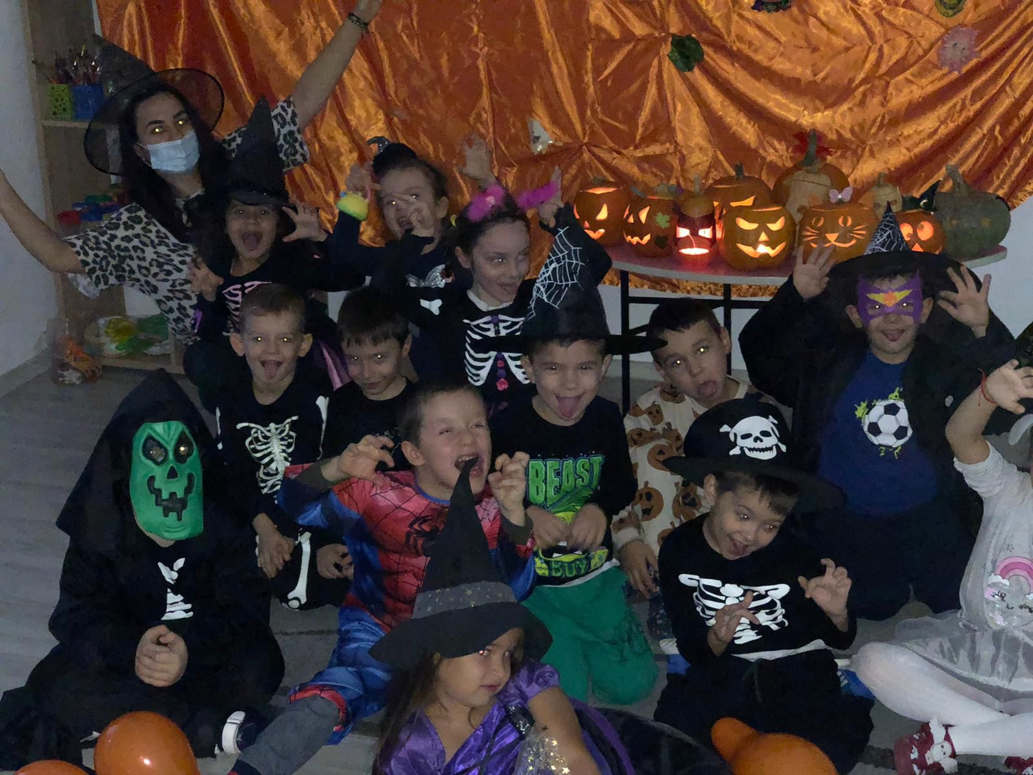
The
Kittens

Slide 17
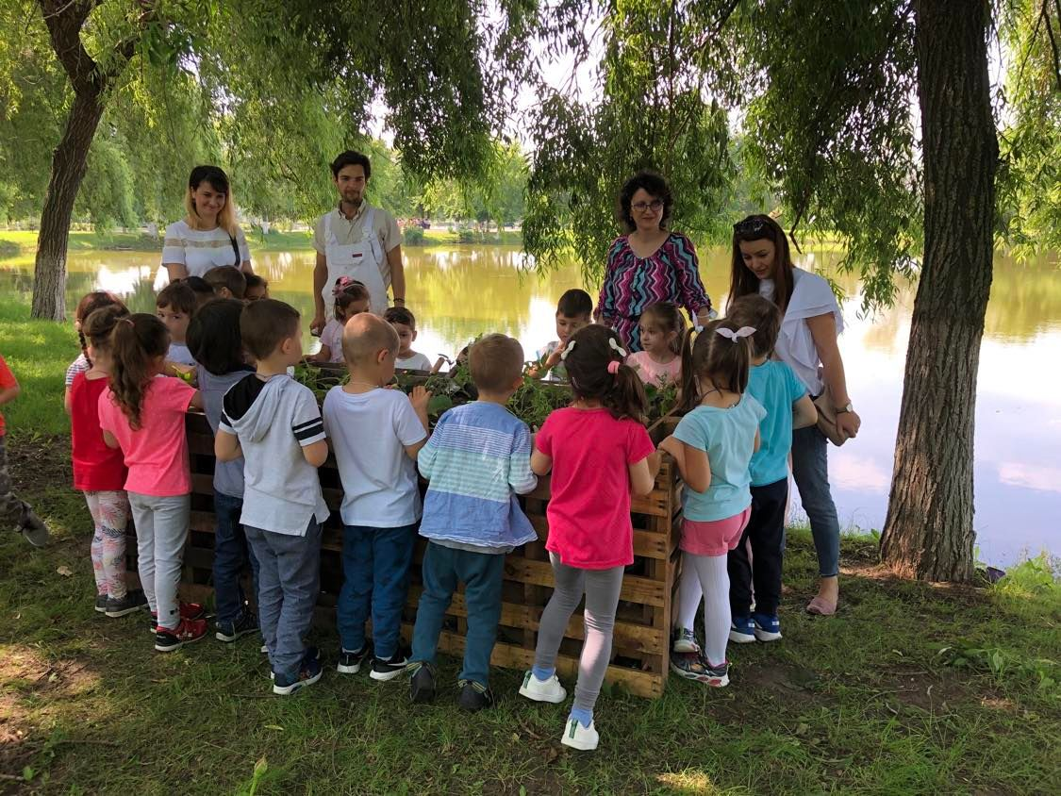
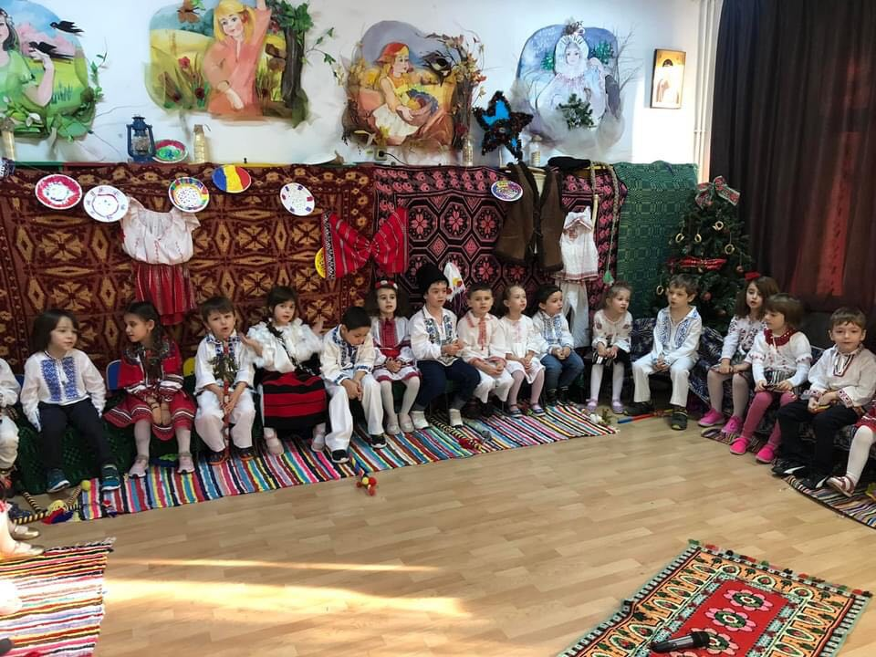
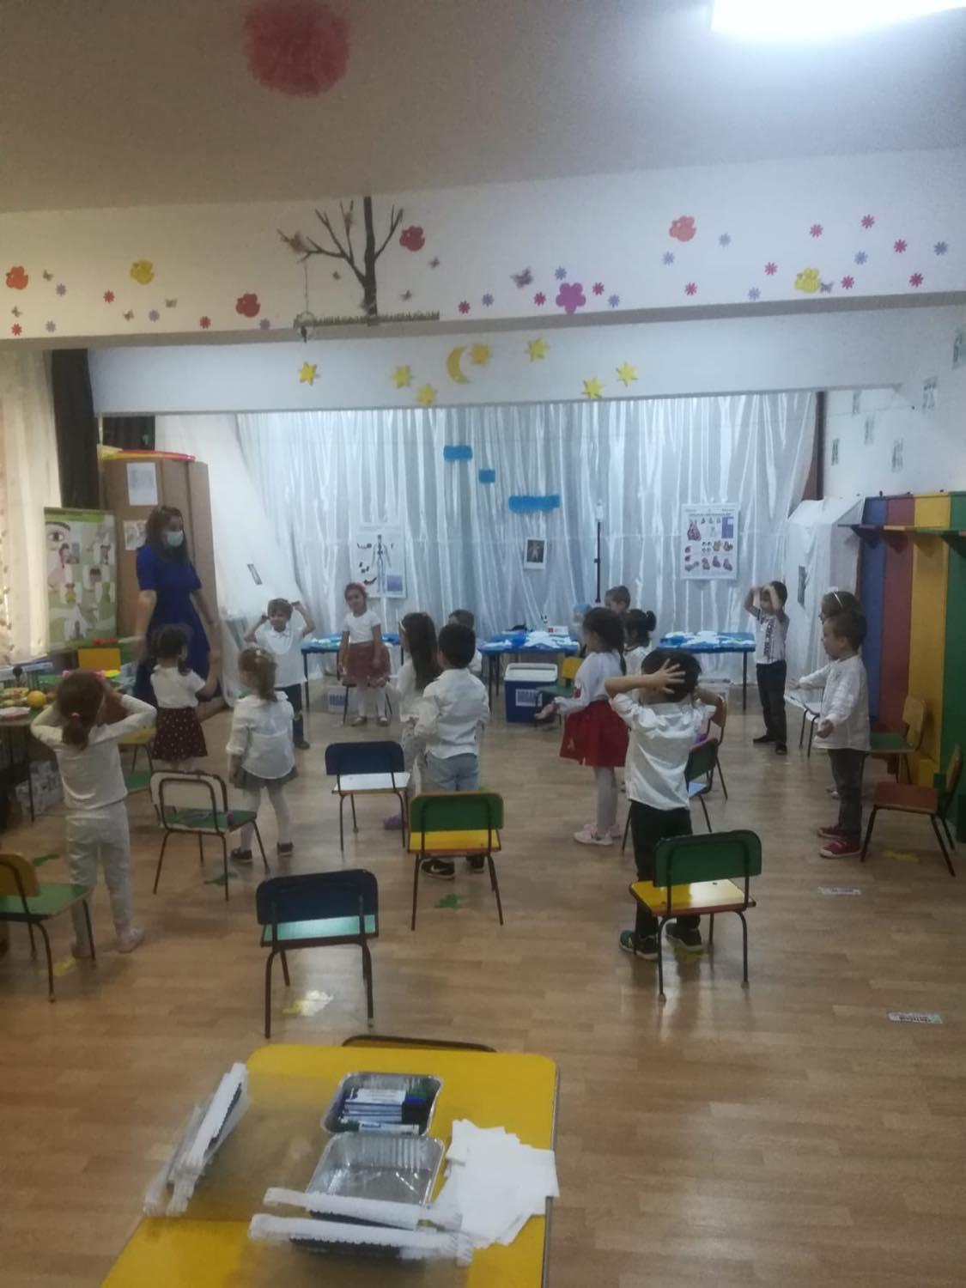
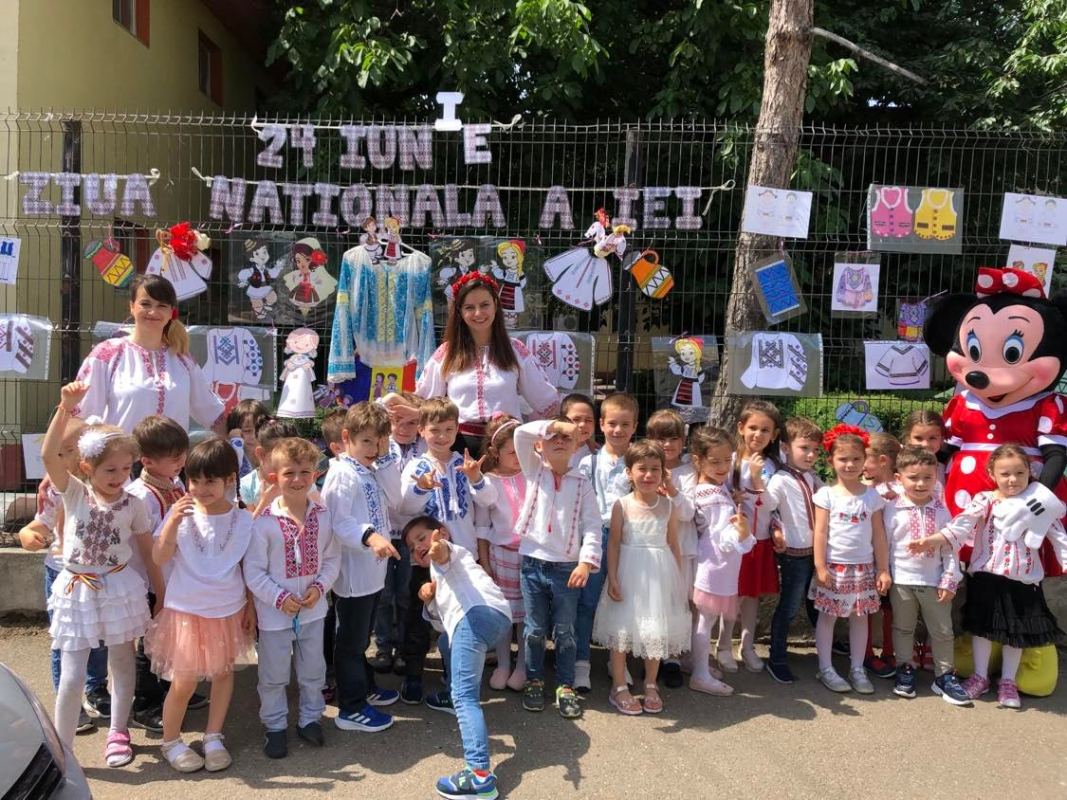
The
Bunnies

Slide 18
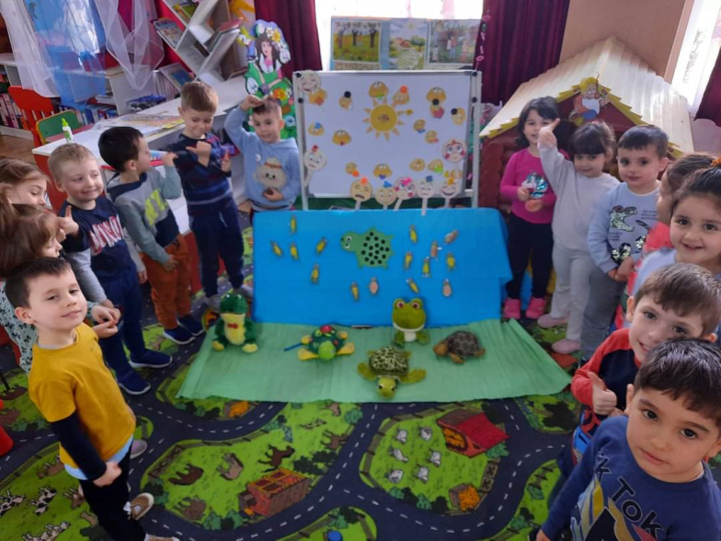
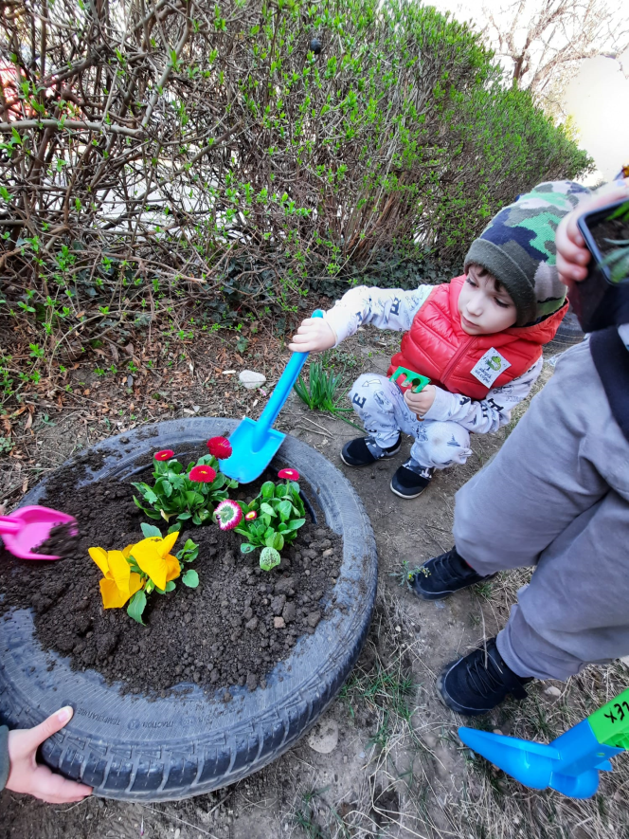
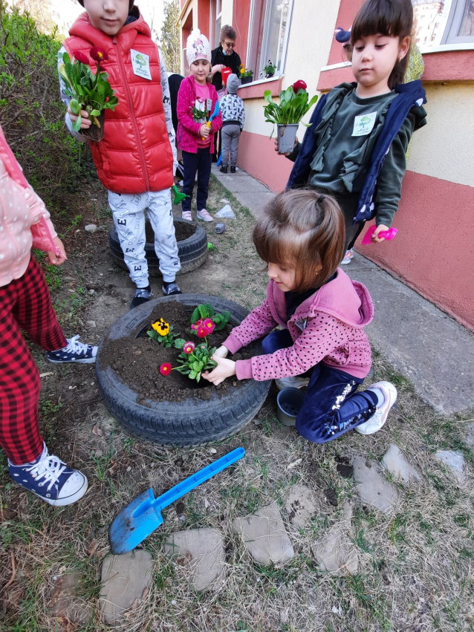
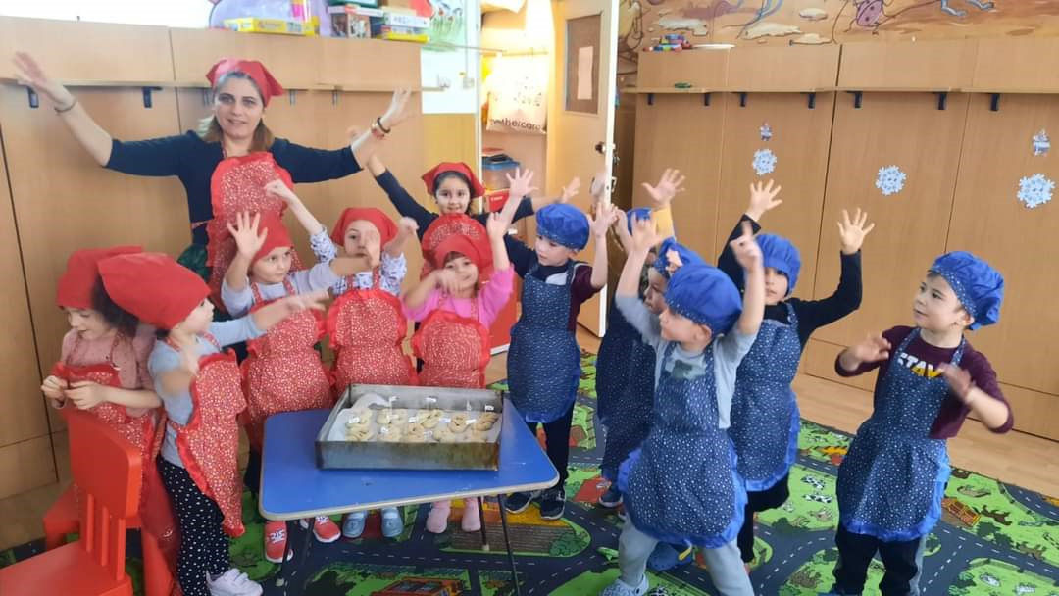
The Dwarfs

Slide 19
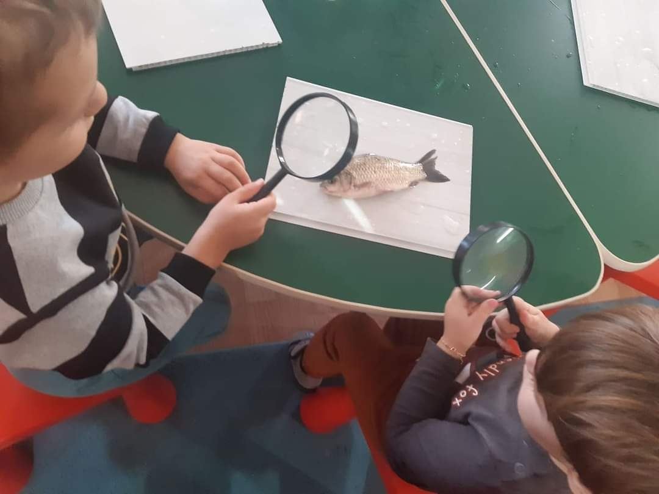
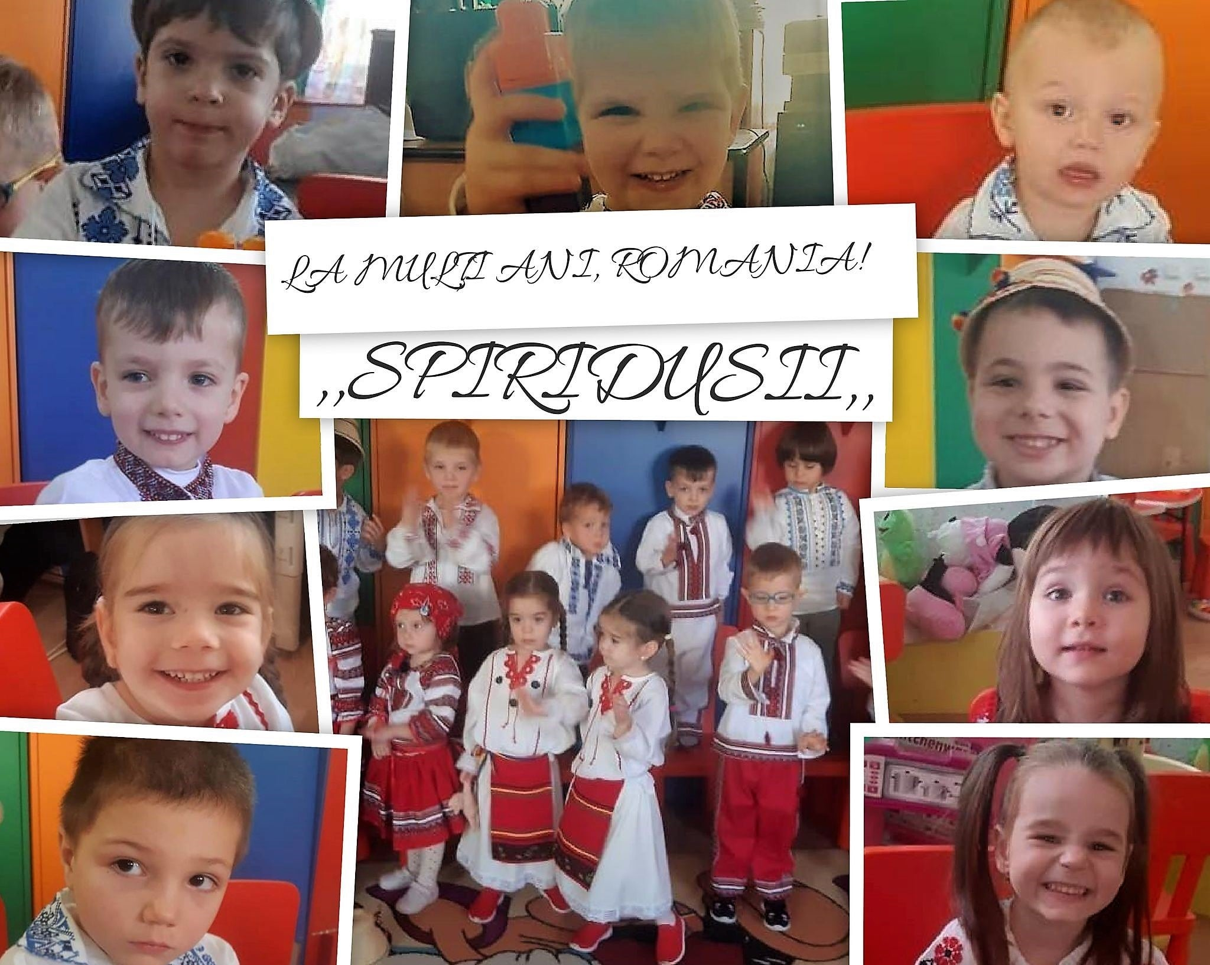


The Elves

Slide 20



During the Covid pandemic, we used various digital apps and tools to connect with the children and support an uninterrupted learning process: www.genial.il/en www.zoom.us www.wizer.me www.meet.google.com
Google classroom
WhatsApp
Facebook

Slide 21
THANK YOU SO MUCH!
G.P.P. BOBOCEI DIN MICRO III, Buzău, Romania
STROE PAULA, Preschool Teacher
CONSTANTIN CATALINA –LOREDANA, Preschool Teacher
GRADINITA G.P.P. BOBOCEI DIN MICRO III,Buzău, România
Teachers:
STROE PAULA- preschool teacher
CONSTANTIN CATALINA -LOREDANA-preschool teacher

